Slide 1
Dyslexia basics
for Parents and Educators

Slide 2
University of utah reading clinic
Dr. Kathleen J. Brown
www.uurc.org
801-265-3951

Slide 3


A Child’s Mind
Phonology = sound /say it! /
Semantics = meaning
Orthography = spelling /b/-/ă/-/t/= bat
all 3 working in parallel → automatic word recognition
bat

Slide 4
He had never seen dogs fight as these wxxxish cxxxxxxxx fxxxxt, and his first exxxxxxxxx txxxxt him an unfxxxxxxxble lxxxxx. It is true, it was a vixxxxxxx exxxxxxxxx, else he would not have lived to prxxit by it. Cxxxx was the vxxxxx. They were camped near the log store, where she, in her friendxx way, made adxxxxxx to a husky dog the size of a full-xxxxx wolf, thxxxx not half so large as xhe. Thxxx was no wxxxing, only a leap in like a flash, a metxx clip of teeth, a leap out exxxxly swift, and Cxxxx’s face was ripped open from eye to jaw.

Slide 5
What Causes Reading Difficulties?
The Source(s) of Reading Difficulties are
<----------------------------------------------------------------------------------->
Constitutional and/or Environmental
(in the child) (outside the child)

Slide 6
Literacy in Schools
80-85% of students with an identified specific learning disability have a primary problem with reading and/or language
10-20%, or 1 out of every 5-10 students, has symptoms of dyslexia (varies with criteria used to determine dyslexia)
—National Institute of Child Health and Human Development (2003)

Slide 7
Dyslexia Basics
Dys = abnormal; but not in a positive way (Greek)
Lexia = word or words (Greek)
Many misconceptions (e.g., seeing backwards, colored lenses, marching, eye training)
Core deficit is in language, specifically, the phonological system (i.e., significant problems matching speech sounds to letters)
Math and oral language abilities typically normal or above

Slide 8
Dyslexia
is not caused by a visual problem
is not caused by lack of motivation
occurs in all socioeconomic levels
occurs slightly more in boys than girls
may occur in spite of good classroom instruction
is resistant to intervention
may occur with other disorders (e.g., ADD)

Slide 9
Dyslexia is…
…a specific learning disability that is neurobiological in origin. It is characterized by difficulties with accurate and/or fluent word recognition and by poor spelling and decoding abilities. These difficulties typically result from a deficit in the phonological component of language that is often unexpected in relation to other cognitive abilities and the provision of effective classroom instruction. Secondary consequences may include problems in reading comprehension and reduced reading experience that can impede growth of vocabulary and background knowledge.

Slide 10
Dyslexia is a specific learning disability that is neurobiological in origin… This definition has been adopted by:
International Dyslexia Association
National Institute of Child Health & Human Development (US Department of Health & Human Services)

Slide 11
Utah State Board of Education Definition of SLD
A disorder of one or more of the basic psychological processes involved in understanding or in using language, spoken or written, that may manifest itself in the imperfect ability to listen, think, speak, write, spell or do mathematical calculations such as perceptual disabilities, brain injury, minimal brain dysfunction, dyslexia and developmental aphasia, that affects a students’ educational performance.
A specific learning disability does not include learning problems that are primarily the result of visual, hearing, or motor disabilities; or intellectual disability; of emotional disturbance; or of environmental, cultural, or economic disadvantage.
—USOE Specific Learning Disability Definition (&300.8©(10)), which relies on the federal definition of a specific learning disability (SLD). May 2, 2013.

Slide 12
Let’s break it down…
Specific learning disability (but not motor, emotional etc.)
Neurobiological in origin (genetic)
Inaccurate or non-fluent word recognition
Poor spelling & decoding abilities
Deficit in phonological component
Often unexpected (other cognitive & schooling)
Secondary consequences

Slide 13
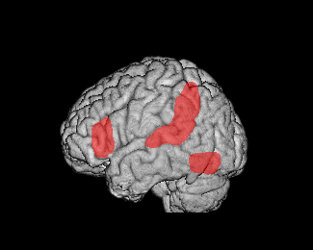
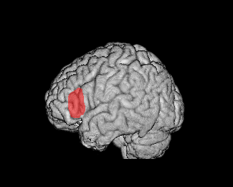
Neurobiological Basis of Dyslexia
Typical Readers
Dyslexic Readers
Eden et al., Neuron, 2004

Slide 14
Let’s break it down…
Specific learning disability
Neurobiological in origin
Inaccurate or non-fluent word recognition
Poor spelling & decoding abilities
Deficit in phonological component
Often unexpected
Secondary consequences

Slide 15
Let’s break it down…
Specific learning disability
Neurobiological in origin
Inaccurate or non-fluent word recognition
Poor spelling & decoding abilities
Deficit in phonological component
Often unexpected (cognitive & schooling)
Secondary consequences

Slide 16
A Non-Dyslexic Child’s Journey in G1
b d
/b/ /d/
Over time, speech sounds and graphemes processed simultaneously (automaticity). No more mistakes!

Slide 17
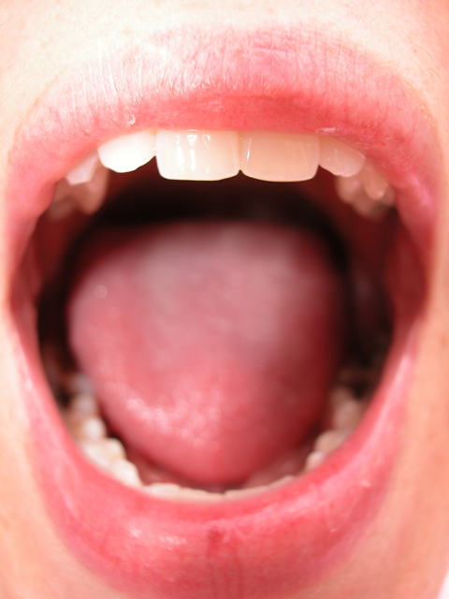
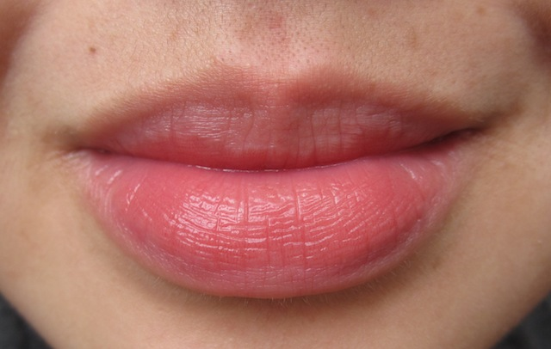
A Dyslexic Child’s Journey in G1 and On
b d
/b/ /d/
quit, quiet, quite and, said
ever, every, very ever what, that

Slide 18
Let’s break it down…
Specific learning disability
Neurobiological in origin
Inaccurate or non-fluent word recognition
Poor spelling & decoding abilities
Deficit in phonological component
Often unexpected
Secondary consequences

Slide 19
Is My Child Dyslexic?
Timed tests of letter-names or letter-sounds in K & early G1
Phoneme awareness (e.g. wug, sim) tasks in K & early G1
Oral reading fluency, a timed test of reading rate and accuracy in connected text
Poor spelling well below grade level expectations
Poor response to basic reading intervention

Slide 20
Identifying Reading Disability in Utah
Utah Schools may use any of the following options:
A. Response to Intervention
B. Discrepancy (1.5 s.d.) between reading achievement & intellectual ability
e.g., IQ = 100 WRMT = 78
C. Combination of A & B above

Slide 21
Students Who Do Not Qualify for an IEP
For students with moderate reading difficulties who do not have IEPs, and who are unlikely to qualify for an IEP, a 504 Plan can be a life-saver!
A 504 Plan will allow accommodations that help a junior high/high school student to keep up with coursework and demonstrate optimum performance on standardized tests (e.g., ACT)
Teachers need to be in the 504 “loop” for the plan to work well. A 504 Plan is not “cheating!”

Slide 22

Effective Intervention for Dyslexic Students is…
Explicit,
Systematic,
Incremental,
Cumulative,
Paced by Data, and,
Focuses on phonics, spelling & practice reading real text.

Slide 23
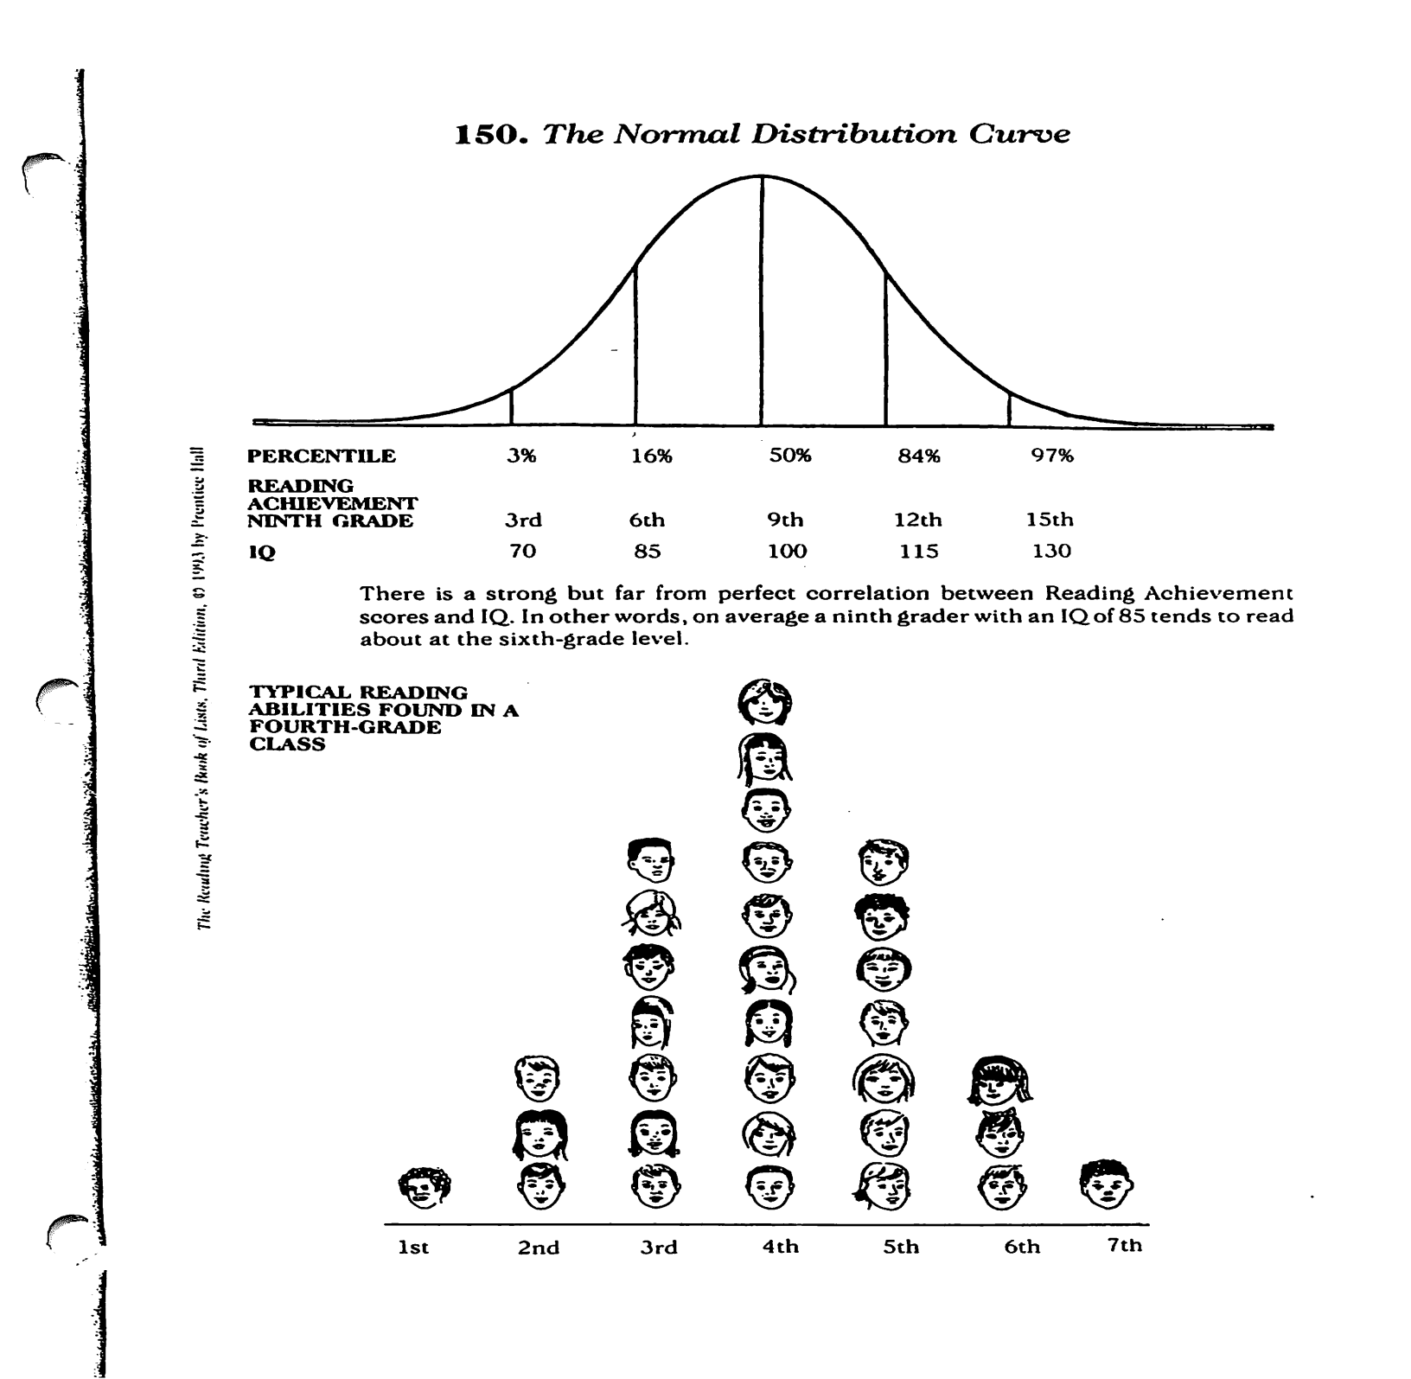

Slide 24
Definition of Terms
Phoneme: An individual speech sound. (/sh/, /ŏ/, /p/)
Grapheme: A letter or letter group that represents a speech sound or phoneme. (sh – o – p)
Morpheme: The smallest linguistic unit in a word that has meaning. (shop + ed)

Slide 25



www.uurc.utah.edu
Handout in tote bag

Slide 26

For More Information
The International
Dyslexia Association
40 York Road
4th Floor
Baltimore, Maryland 21204
www.interdys.org
1-800-ABCD123
410-296-0232

