Slide 1
Changes in Commercial Text
for Beginning Readers:
What Are Kids Asked to Do?
Dr. Kathleen J. Brown
University of Utah Reading Clinic, Director Emeritus
April 21, 2023

Slide 2
We Would Do Well to Remember…
Thorndike’s Laws of Learning (1903)
- exercise (practice)
- identical elements (keep some stuff the same)
- readiness (appropriate rigor/pace for new stuff)
- effect (learner appreciates outcome)
These laws influenced “vocabulary control” aka word choice in commercial reading programs.

Slide 3
Applying Thorndike’s Laws
Text written and produced by publishers
(e.g., Scott Foresman, Ginn, 1930-1985)
- emphasized Whole Word a.k.a. Look-Say method
- heavy use of high frequency words (e.g., look, said)
1956 Scott Foresman Preprimer #1 used
17 unique words at least 12x each

Slide 4
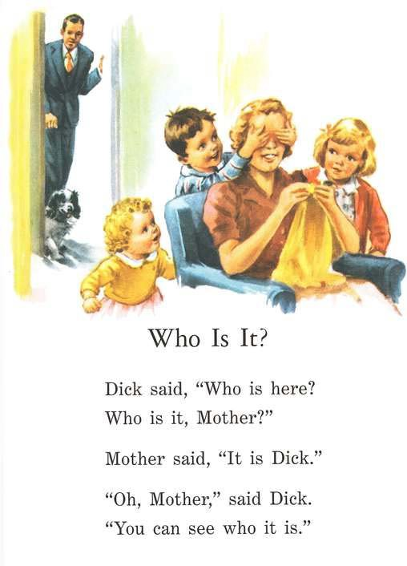
T’s Laws are:
exercise
identical elements
readiness
effect
Are T’s Laws met? Which ones and how?
Scott Foresman

Slide 5
After Indictments by
Flesch, 1955 & Chall, 1967
phonics skills not represented in text (primarily high frequency words (e.g., Dick and Jane)
- 1965+ some publishers applied Thorndike’s Laws to create decodable text
- Lippincott
- Sullivan
- SRA-DISTAR
- SRA Reading Mastery
- many of the decodable texts in use today.

Slide 6
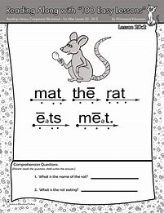
Applying Thorndike’s Laws
T’s Laws are:
exercise
identical elements
readiness
effect
Are T’s Laws met? Which ones and how?
Englemann, S. (1975). Mat the Rat. DISTAR Training Program for DISTAR Reading I.. Chicago, IL: SRA.

Slide 7
T’s Laws are:
exercise
identical elements
readiness
effect
Are T’s Laws met? Which ones and how?
Rasmussen & Goldberg. (1964). A Pig Can Jig. SRA Basic Reading Series-Level A. Chicago, IL: SRA.

Slide 8
Thorndike Who? Phonics What?
A whiplash pendulum swing away from basals decodables, and phonics (i.e., stultifying, lack of respect for kids & teachers’ ability, inherently evil).
→1987 CA & 1990 TX single adoption markets drive text re-design. Teachers/Admins in these states were into…
- whole language→ unabridged literature &
predictable text for K-G2

Slide 9
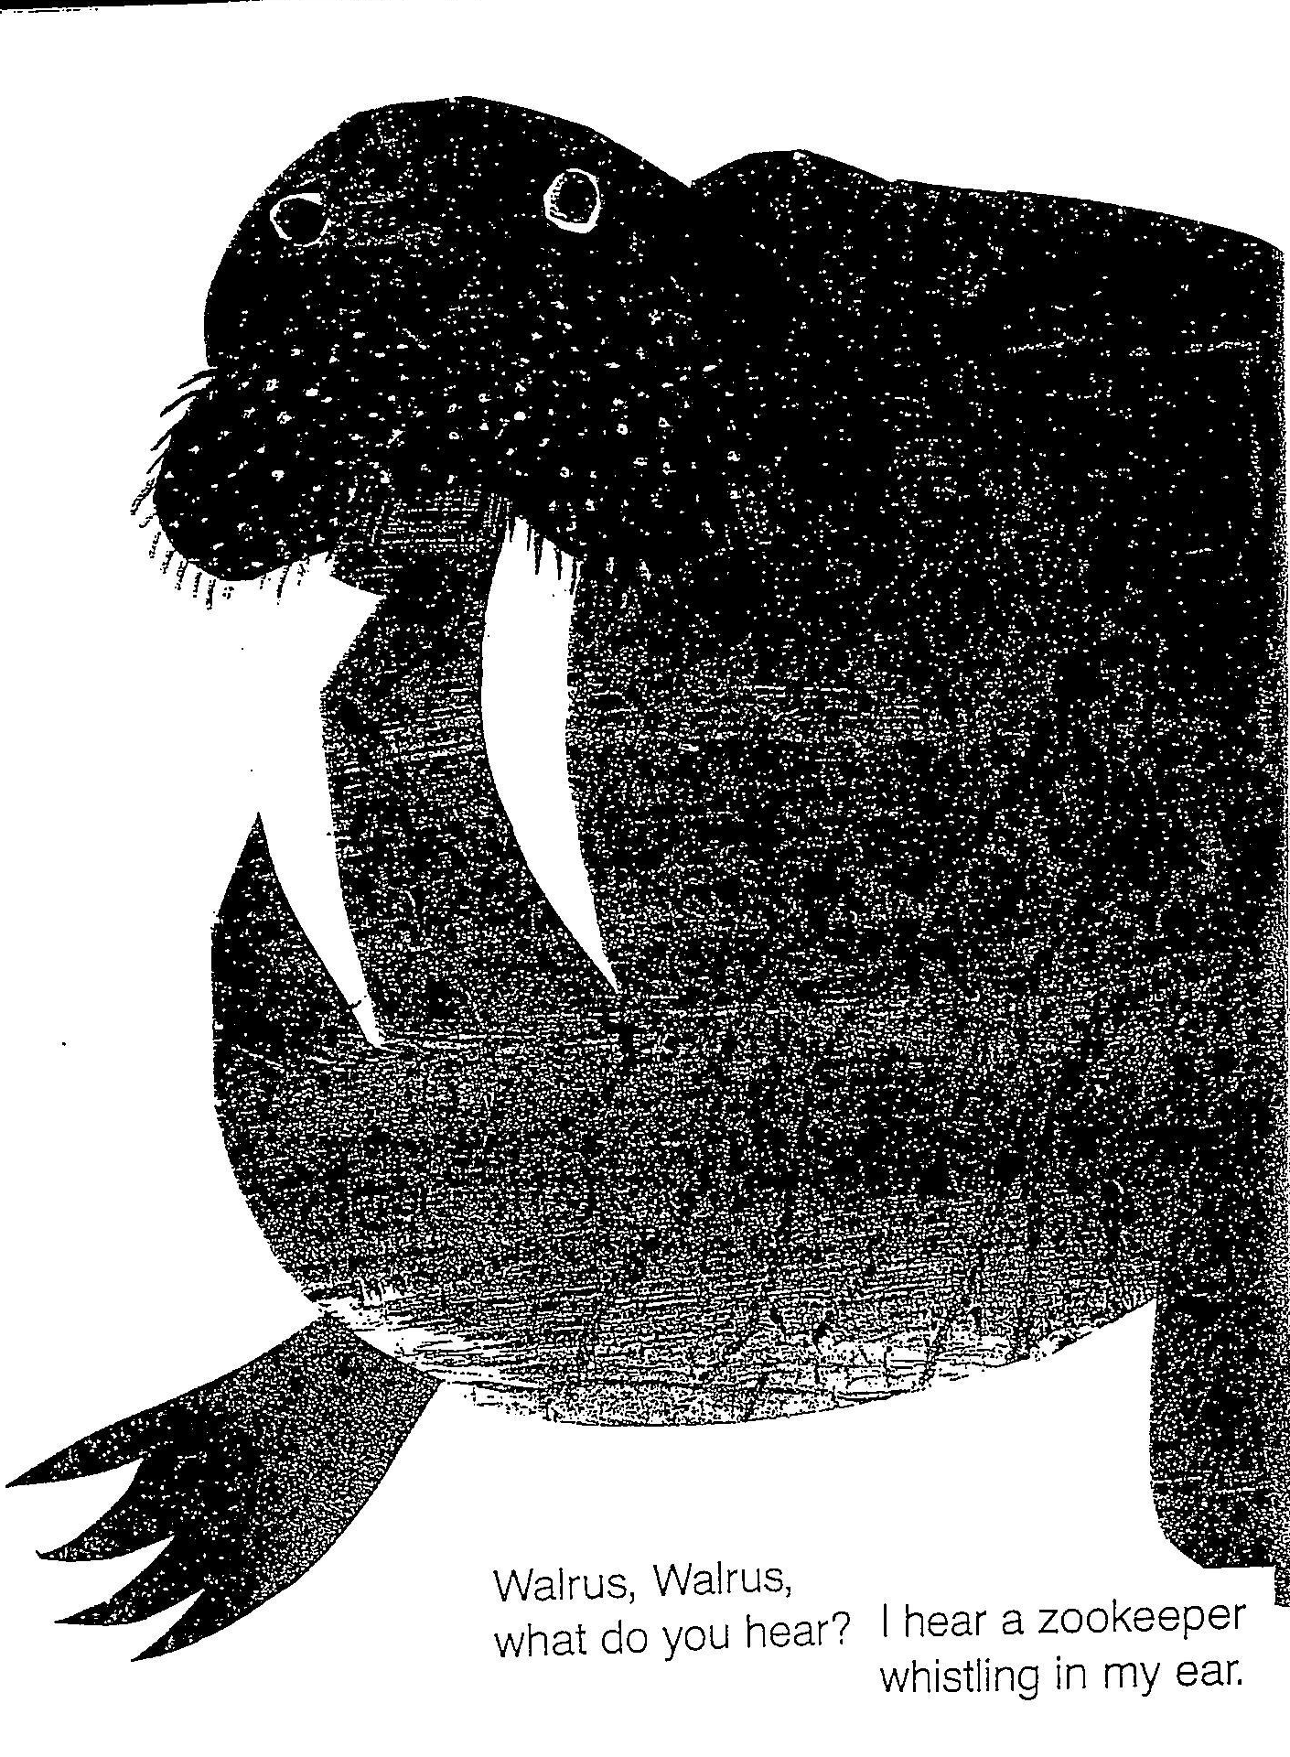
T’s Laws are:
exercise
identical elements
readiness
effect
Are T’s Laws met? Which ones and how?
Martin, B. & Carle, E. (1967). Brown Bear, Brown Bear, What Do You See? NY: Henry Holt & Company.

Slide 10
Back to Phonics & More Changes in Text
Hue & cry over 1995 CA NAEP G4 scores = LA
(39th in US)
- 1997-2000 decodable mandates in CA (75%) & TX (80%)
Changes in 1997+ Core Programs = literature + decodables
to be everything to everybody: EL, Tier II, G&T, balanced literacy…
G1 kids couldn’t read the “main selections” even after the teachers read them aloud. Too many unknown words with complex features and not enough repetition too early in the school year (Juel & Roper-Schneider, 1985; Reitsma, 1983)
DUH.

Slide 11
T’s Laws are:
exercise
identical elements
readiness
effect
Are T’s Laws met? Which ones and how?
Tyler, N. (2008). Ants. Core Decodable #10. McGrawHill SRA, Chicago, IL

Slide 12

Unit 1, Grade 1.1,.Move It. (2017). Wonders Literature Anthology. McGrawHill SRA, Chicago, IL

Slide 13
Heibert , 2005, ESJ; 2009, chapter
Analyzed Scott Foresman, 1962 – 2007
(only remaining program examined by Chall 1967/1983)
- K = mid year decodables
- G1 & G2 = main selection texts
- pulled 2,000 words (or 10 units) from a grade level
- coded words: 0-7 zones of frequency in written English:
→zones 0-2 = HF at least 100x in 1M words n= 930 words
→ 6-7 = rare only .01-9x in 1M words n=150,000 words
Remember this number!

Slide 14
Heibert , 2005, ESJ; 2009
Identified 2 dimensions of text that affects beg readers:
1. # new, unique words per 100 words (cognitive load)
Then, take those new, unique words & look at linguistic load:
2a. Frequency: # HF words (zones 1-2), moderate (zones 3-4), rare (zones 5-6)
2b. Decodability of words in zones sorted into categories:
- 1-3 graph/phon 1:1 (at, go)
- 4-5 vowel digraphs (ate, eat)
- 6-7 r-con & diphthongs (oar, owl)
- 8-9 polysyllabic
Remember these breakdowns!

Slide 15
What Is a New, Unique Word?
Count new unique words appearing in 100 words. (n=54)
Nat is at school. Nat sat. What does Nat have? Nat has Sam. Nat does not have Sam!
2 3 4 5 6 7 8 9 10 11
Sam sat. Sam is with Pam. Look! Sam can read. Can Nat? Nat can. Nat and
12 13 14 15 16
Sam like school.
17 18
Why do we have rules at school? Rules can help us get along. Rules can help us stay safe.
19 20 21 22 23 24 25 26 27 28 29
We raise our hands. We listen quietly. We obey safety rules. We let everyone play. What
30 31 32 33 34 35 36 37 38 39 40
are your school rules?
41 42
Pip sits. Pip looks. Pip can jump! Pip is out. Go Pip! Pip looks up. It is very big. Pip can
43 44 45 46 47 48 49 50 51 52 53
look down. Pip…
54
Nat and Sam. Rules at School. Go, Pip! (pp.- 7-34). (2017) Wonders Literature Anthology Grade 1.1 NY: Mc Graw-Hill Education

Slide 16
What Is a New, Unique Word?
Count new, unique words in next 100 words.
…will go in. Will this hat fit Pip? It will! Pip will go here. Pip can look. Where will Pip go?
1 1 2 2 3 4 3 5 4 6 5 6 7
Pip will go home!
8
I live in the country. I live in a house. Not many people live near us. I live in the city. I live in
9 10 7 11 12 13 14 8 15 16 17 18 19
a big building. Lots of people live here.
9 20 21 22 23
I live in the country. I play in my yard. Lots of kids play with me. I live in the city. I play in
10 24 25 26 27 28
the playground. Lots of kids play with me.
29
I live in the country. My school is far away. I…
11 12 30 31
(n=31 new, unique words; 12 used in previous text, →43 unique words,)
Go, Pip! & I Live Here (pp. 34-47). (2017). Wonders Literature Anthology Grade 1.1 NY: Mc Graw-Hill Education

Slide 17
What Is a New, Unique Word?
Count new, unique words in next 100 words.
…ride the bus. I live in the city. My school is near my home. My mom walks with me.
1 1 2 2 3 4 5 6 7 8 3 9 4 5 6 10 11
Where do you live?
7 8 9
Flip is my pet. Flip is big. Flip can not go in. Flip is sad. Flip pulls me in. Flip and I go
10 11 12 13 14 15 12 13 16
to class. Flip sits. Be good, Flip! Flip likes class. The kids like Flip. Miss Black is mad.
14 15 16 17 18 19 17 20 21 22 23
Sit down, Flip. Look at Miss Black. Flip has a plan. Flip did it! The class claps. Can
24 25 18 19 26 20 27 28 21 29 22
Flip come back? “Flip can,” said Miss Black. Flip is glad!
30 31 32 33
What do pets need? Like all living…
34 35 36 23 37 38
(n=38 new, unique words; 61 unique words, 23 used in previous text)
I Live Here & Flip (pp. 47-61). (2017). Wonders Literature Anthology Grade 1.1 NY: Mc Graw-Hill Education

Slide 18
Text | 1962 G1 | 1983 G1 | 1993 G1 | 2000 G1 | 2007 Kinder G1 | 2017 Wonders Kinder G1
Beginning of Year Text Average # New, Unique words/100 Running Words | 10 | 5 | 29 | 21 | n/a | n/a 32 in 2 samples
Middle of Year Text Average # New, Unique words/100 |  |  |  |  | 12 22.9 | n/a
End of Year Text Average # New, Unique words/100 | 8 | 10 | 20 | 19 | n/a
What is the trend for new, unique words in PP1 text over time?

Slide 19
Text | 1962 G1 | 1983 G1 | 1993 G1 | 2000 G1 | 2007 Kinder G1
Beginning of Year Text Mean # New, Unique words/100 | 10 | 5 | 29 | 21 | n/a
Middle of Year Text Mean # New, Unique words/100 |  |  |  |  | 12 22.9
End of Year Text Mean # New, Unique words/100 | 8 | 10 | 20 | 19 | n/a
Average Repetition of Words | 10 | 20 | 3.4 | 4.8 | 4.5
Singletons BOY - EOY | 0 - 7 | 5 - 17 | 46 - 41 | 41 - 42 | n/a
What is the trend for word repetition in Scott Foresman G1-End text over time?
What is the trend for singleton words over time?

Slide 20
Text | 1962 G1 | 1983 G1 | 1993 G1 | 2000 G1 | 2007 Kinder G1
Beginning of Year Text Mean # New, Unique words/100 | 10 | 5 | 29 | 21 | n/a
Middle of Year Text Mean # New, Unique words/100 |  |  |  |  | 12 22.9
End of Year Text Mean # New, Unique words/100 | 8 | 10 | 20 | 19 | n/a
Average Repetition of Words | 10 | 20 | 3.4 | 4.8 | 4.5
Singletons BOY - EOY | 0 - 7 | 5 - 17 | 46 - 41 | 41 - 42 | n/a
% Words in 1000 Most Frequent (i.e., Zones 0-2) |  |  |  |  | 58 82
% decodable words in zones 0-2 |  |  | 29 | 30 | n/a
Average Decodability in Zones 0-1 |  |  |  |  | 4.0 5.3
1-3 graph/phon 1:1 (at, go)
4-5 vowel digraphs (ate, eat)
6-7 r-con & diphthongs (oar, owl)
8-9 polysyllabic
Whole Language
Zones 0-2: Too large a corpus?
Whole Word
What kinds of decoding tasks do these texts pose?

Slide 21
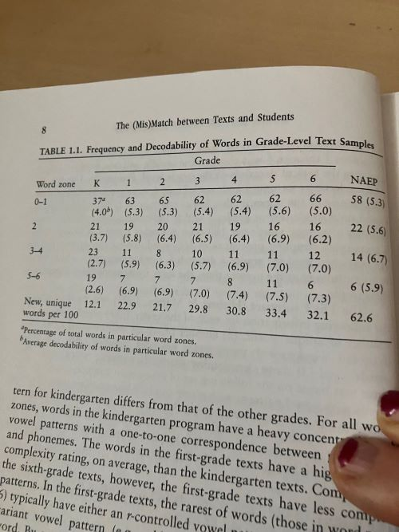
Heibert , 2005, ESJ; 2009
Heibert, E.H. (2009). The (mis)match between texts and students. In E.H. Heibert & Sailors, M.
Finding the Right Texts: What Works for Beginning and Struggling Readers (pp. 1-20). NY: Guilford.

