Slide 1


How to Help Your Struggling Reader at Home
Please access this presentation @
http://www.uurc.utah.edu/Educators/Links.php
Strategies & Resources for Parents
Presented by Holly Dean M.Ed.
Intervention Specialist
University of Utah Reading Clinic Wasatch Reading Summit
October 7-8, 2016

Slide 2
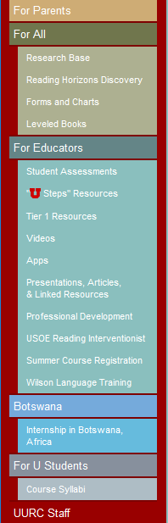
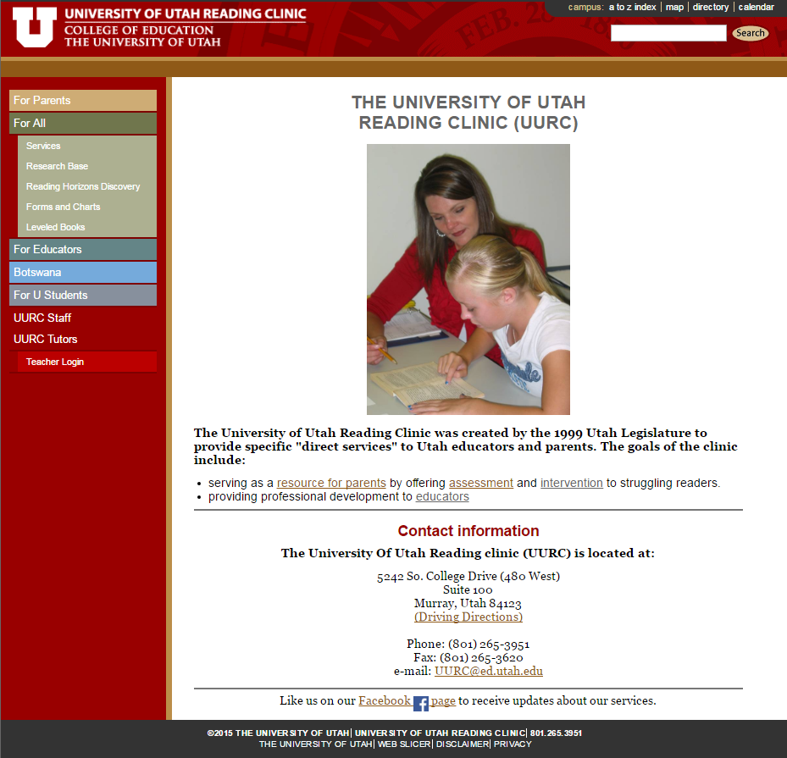
www.uurc.utah.edu
Please access this presentation @
http://www.uurc.utah.edu/Educators/Links.php

Slide 3
What Makes Learning To Read So Difficult?
Learning to read is not natural or easy for most children. Reading is an acquired skill, unlike spoken language…..
-Louisa Moats
Reading requires language knowledge and language proficiency. Students require instruction that develops awareness of sounds, syllables, meaningful word parts, relationships among word meanings, and the structure of written text. -Teaching Reading IS Rocket Science
Word Recognition
correctly and quickly
Fluent Reading
minimal effort spent on decoding
more effort devoted to understanding/comprehending

Slide 4
Is my child a struggling reader?
Most common symptom of difficulty?
Poor fluency – rooted in difficulties with word recognition
*The ability to sound out words is a major foundation that allows rapid recognition of words “by sight”.
Difficulties recognizing words = guessing
unreliable and inefficient
prolongs and contributes to poor word recognition

Slide 5
2 Areas to Focus on at Home
Foundational Skills
decoding (phonics)
word recognition
Working in Text
reading fluency

Slide 6


http://athome.readinghorizons.com/workshop/overview
Parent Online Workshop
athome.readinghorizons.com

Resources

Phonics Training
Free to anyone for 30 days

Slide 7
Workshop Overview
Introduction
research based
explicit and systematic phonics
multi-sensory
Marking System
allow students to examine the internal structure of words, identifying likely and unlikely patterns
Delivery Method
active learning
visual cues aid memory
repeating-verbal cues
Multi-Sensory Approach
auditory
visual
kinesthetic
Pacing/Scope
use as a reference

Slide 8
Syllabus- Areas of Focus
letter groups 1-5
phonetic rules 1-5
decoding skills 1-2
spelling rules
spelling c & k
many jobs of y
short vowel sounds
long vowel sounds
special vowel combinations
special vowels sounds
blends
diagraphs
digraph blends
diphthongs
plurals
suffixes
decoding words of any length
exceptions

Slide 9
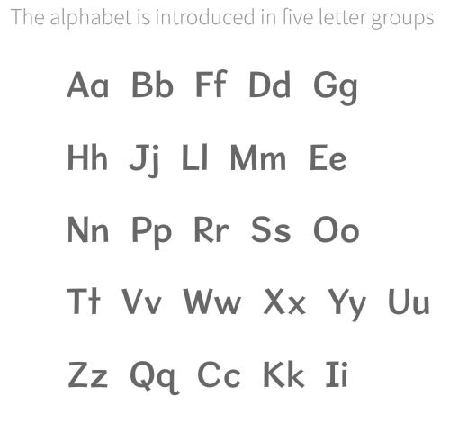
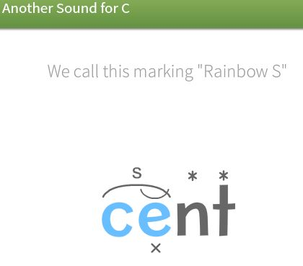
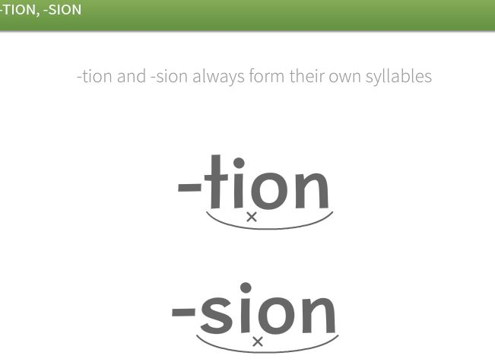
Modules are short and descriptive easy (foundational) complex (advanced)
letter groups 1-5
Instruction time varies
Practice = examples vary
spelling c & k
Instruction = 2:00
Practice = examples to mark
other suffixes
Instruction = 2:32
Practice = examples to mark

Slide 10

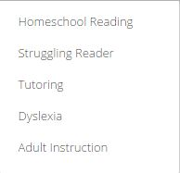
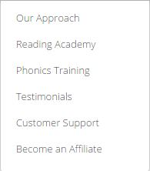
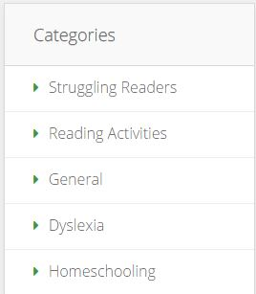
On the Website
Solutions
Resources
Blogs
http://www.uurc.utah.edu/General/Workshops.php
Join us at the UURC Nov. 9-10 for the Reading Horizons Workshop

Slide 11
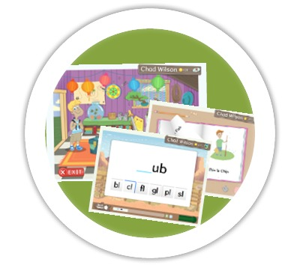
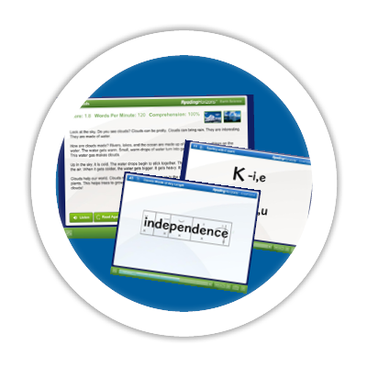
Software for your child to use at home
For Younger Learners (Ages 4-9):
Reading Horizons Discovery uses characters, games, and themes to engage younger learners while providing them with a solid foundation in reading skills. Full-color books help younger learners transfer the decoding skills they learn in the program to engaging and relatable stories.
For Older Learners (Ages 10+):
Reading Horizons Elevate appeals to older learners and struggling readers by developing the basic skills they need to master in a way that respects their maturity level. Older learners enjoy the autonomy and privacy offered through software instruction. To further engage and interest students, a library of reading passages is also included.
You can get more information about this software on our website
uurc.utah.edu

Slide 12
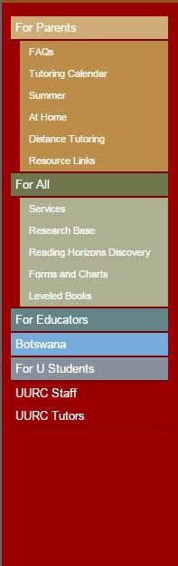
www.uurc.utah.edu
all materials are
FREE!

Slide 13

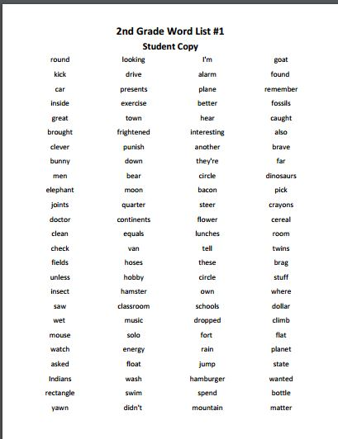
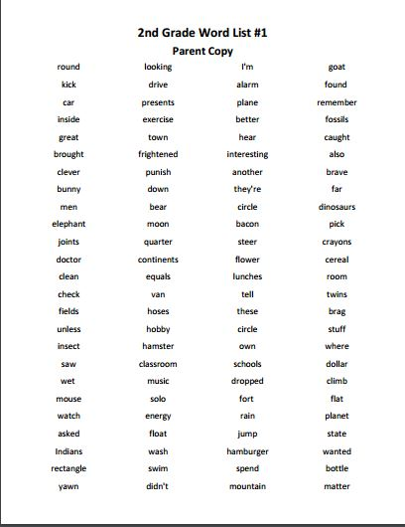
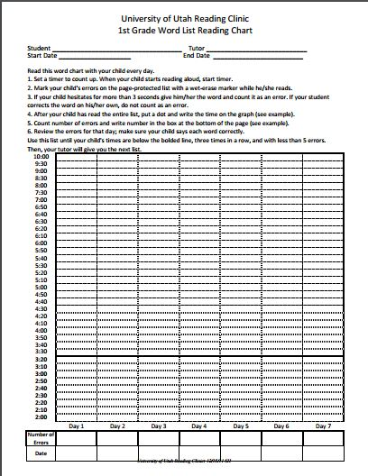
Grade Level Academic Word Lists & Charts
Home Word Charts
Choose grade level
Choose chart #
Print student & parent copy
Print chart
Follow directions on chart
Chart progress

Slide 14
The Importance of Fluency
“the ability to read quickly, effortlessly, and efficiently with good, meaningful expression” -Tim Rasinski
Your child’s rate must be fast enough to allow him/her to comprehend text
BUT…….
Fluency is more than speed. Fluent readers make their message understood:
they read in phrases
they respect intonation patterns in sentence structure
they communicate with the listener
What does dysfluent reading sound/look like?
fragmented and choppy
reads word-by-word
too many unfamiliar words
lacks knowledge of vocabulary
ignores punctuation
sounds out sight words
tires easily and/or falls apart

Slide 15
Your Child’s Reading Level
Independent Reading Level
Highest level your child can read without help
Adequate background knowledge
Can access this text very quickly and with very few errors
Instructional Reading Level
Highest level you child can read with some assistance
Adequate background knowledge
Can access text fairly quickly with few or no errors
Frustration Reading Level
This level requires extensive or even moderate assistance
Your child does not have adequate background knowledge on a topic

Slide 16
Now you are ready to practice at home
Home reading routines & materials should meet three conditions:
  Cell phones should be put away and the TV turned off.
  Your child should find the topic interesting.
  The text should be is on his/her instructional or independent level. A good rule of thumb here is that more than 1 error per every 10 words means the text is too hard.
Take turns reading every other page. Stop occasionally and talk about what's happening. When oral reading time is up, tell your child to read silently for another 15 minutes, and give a guiding question that you'll want answered (e.g., Why is Ron so mad at Harry?).

Slide 17


Finding The Right Text For Your Reader
Websites to help you find books on your child’s level. It is time to read, read, read!
http://www.arbookfind.com
Accelerated Reader (ar)
BL = 5.7
http://www.scholastic.com/bookwizard
Scholastic
grade level equivalent = 5.8

Slide 18
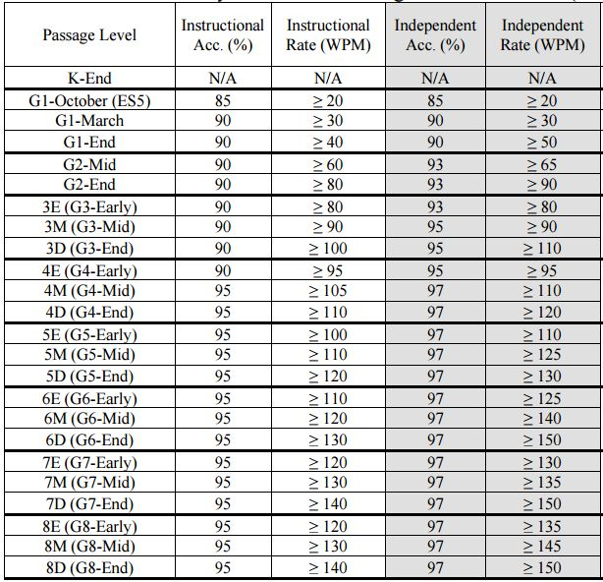
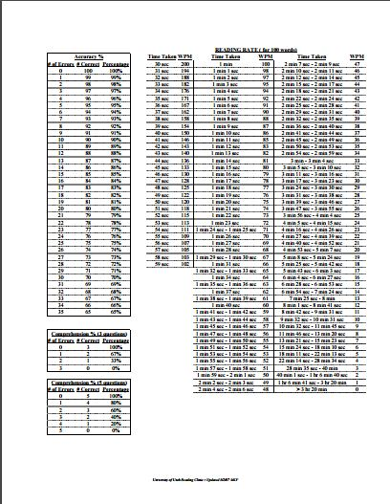
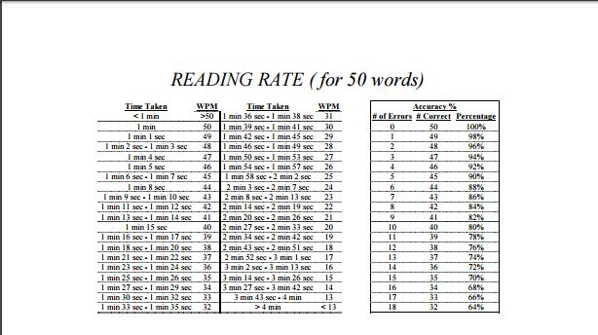
Fluency Criteria Chart
Independent level criteria for a 5.8 book
97% accuracy and > 130 words per minute
Rate Conversion Charts

Slide 19
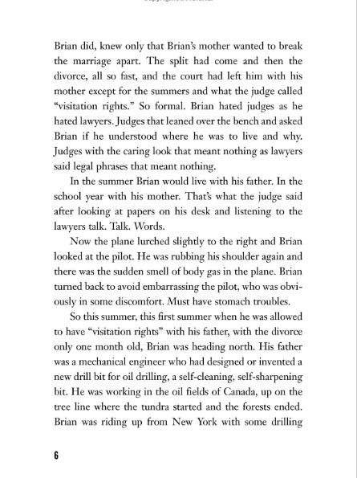
Checking for Accuracy & Fluency
Independent level criteria for a 5.8 book
97% accuracy and > 130 words per minute
Count out 100 words
Mark starting and ending points
Start timer at 0:00
Begin timer when your child begins to read
When your child finishes stop timer
Look up the time (i.e. :43) on conversion chart
That is your rate (140 wpm)
How many errors? (i.e. -3)
That is your accuracy (97%)
97% and 140 wpm
MEETS CRITERIA ! Great book to read at home.
Rate Conversion Chart

Slide 20
TextProject textproject.org
Quality Complex Text
TextProject is a website designed specifically to bring beginning and struggling readers high levels of literacy through a variety of strategies and tools – particularly the texts used for reading instruction
High-quality student texts FREE to download
Vocabulary lessons and lists
Open access resources for all

Slide 21


Classroom Materials
Students Texts

Slide 22
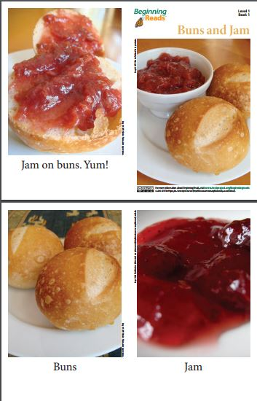
Beginning Reads
Connect student’s oral language knowledge with written language. The texts do this by placing a premium on words that are both highly concrete and phonetically regular—words such dog, cat, pet, and big.
Book I Level I

Slide 23
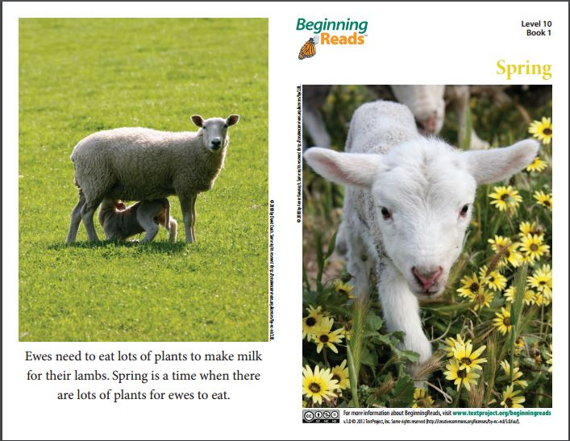
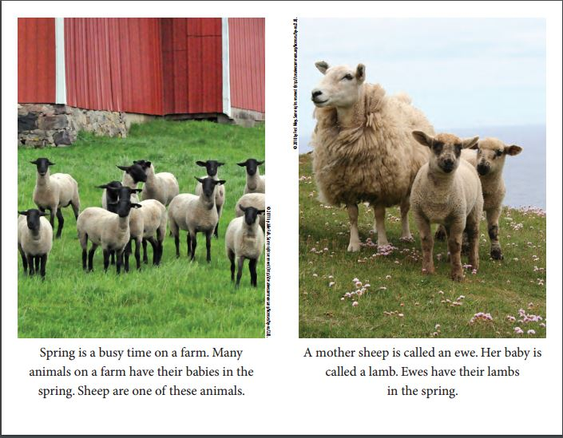
Book I Level 10

Slide 24
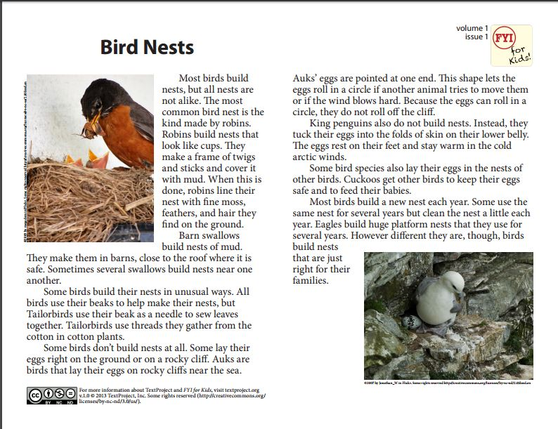
FYI for Kids
collection of engaging and high-quality magazine articles
text that is essential for increasing students’ engagement
text that is essential proficiency with complex texts—
short engaging articles that communicate critical information http://textproject.org/classroom-materials/students/fyi-for-kids
Volume 1 Issue 1
90% of words in text come from 4,000 simple word families-the other 10% are ‘extended vocabulary’.
Volume 1 text contains 1% of that extended vocabulary, and so on.

Slide 25
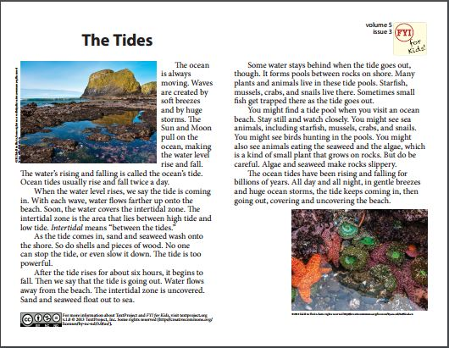
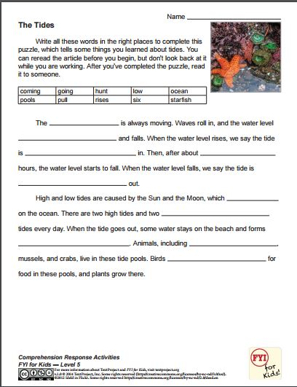
Volume 5 Issue 3
Comprehension Response Activity

Slide 26
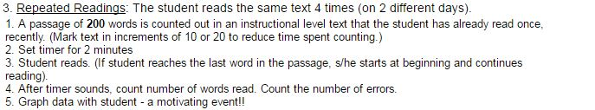
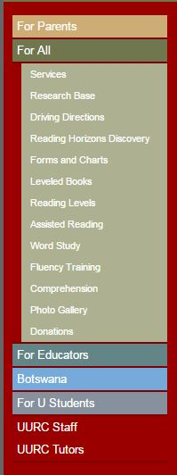
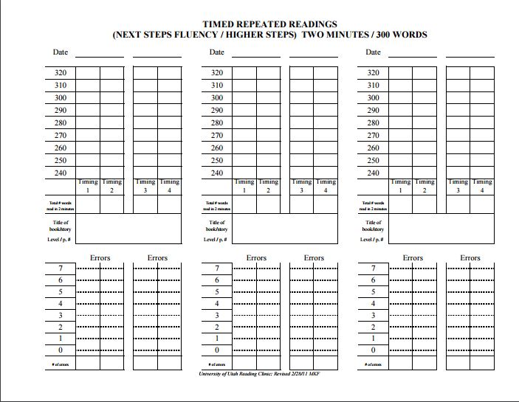
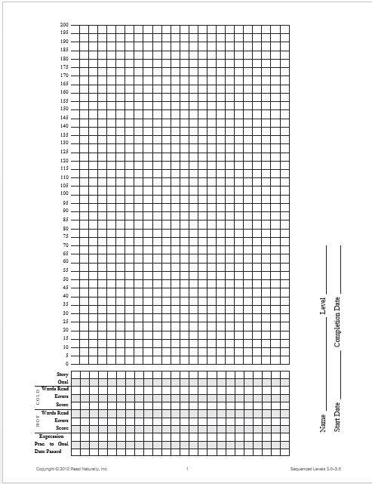
Fluency Training
Instructions and Graphs

Slide 27
Fluency Practice at Home
- Repeated Readings
Use text your child has read at least once- independent or instructional level
They will read the same text 4 times
Count out 200 words-mark with
Mark a * where the timing will begin
Set the timer for 2 minutes [2:00] 
Student reads, you follow & track errors
Count words read after timer sounds
Count the # of errors and fix
Do this 2x in each sitting
Graph the data with your child
Highly motivating!

Slide 28

Audiobooks
Materials for K-12, college, professionals
Core curriculum textbooks
Best-sellers
Membership $135/year
Fees waivers available – apply for assistance

Slide 29

Over 80,000 titles search by
Category Subject Grade
VOICEtext Books
Audiobooks highlighting words as students read along reinforcing:
word ID
decoding skills
reading fluency

Slide 30

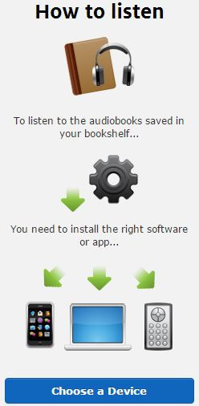
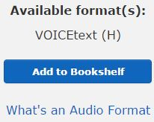
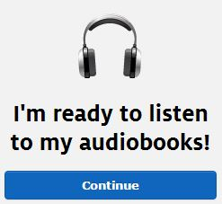
How to get started

Slide 31
To Listen
ipad demo
Personalize with adjustments to:
Text size and color
Background color
Speed of reader voice
Pitch of reader voice

Slide 32
Research Shows:
76% Improved Reading Comprehension
67% Increased Motivation
61% Improved Self-confidence
60% Improved Attitude Toward Reading
52% Improved Reading Accuracy

Slide 33
Eligibility for Services
Learning Ally’s mission is to help those who learn differently. You will need to provide documentation.
IEP / 504 Plan
No IEP or 504 Plan, but a clinician has diagnosed me with a print disability
Bookshare or NLS member
I don’t have any documentation

Slide 34


Livescribe Echo Smartpen

Slide 35


Echo Smartpen & Notebooks

Slide 36
Recording the Teacher/Presentation
electronic pen also records audio
hit record at the bottom of the paper
microphone built into the digital pen records audio of presentation
you write key words to highlight parts of the presentation
audio syncs to the notes
return to any point in the audio presentation by simply touching a word or sketch in your notes
adding audio to notes gives your child a comprehensive record of the important points

Slide 37
Some Reviews
PROS The smart pen syncs audio from presentations or lectures to your handwritten, digitized notes
CONS You must buy/use paper printed with a special microdot pattern
OVERALL While it's noticeably larger than a standard ink pen, the Echo Smartpen is an excellent pen for taking comprehensive notes with audio

Slide 38


Apps
Dr. Cheeseman’s App Chat
https://dyslexiaida.org/dr-cheesmans-app-chat-spelling
https://dyslexiaida.org/dr-cheesmans-app-chat-vocabulary-morphology
https://dyslexiaida.org/dr-cheesmans-app-chat-dont-miss-these-award-winning-apps-for-vocabulary-and-comprehension
https://dyslexiaida.org/dr-cheesmans-app-chat-find-the-best-literacy-apps-for-preschool-and-kindergarten-children

Slide 39
Reference Sites/Apps For your Child
Dictionary.com (+app)
Thesuarus.com (+app)
The Visual Thesaurus (no app)
WordSift (no app)
Dragon Dictation (app)

Slide 40
Thank You !
Please access this presentation @
http://www.uurc.utah.edu/Educators/Links.php
University of Utah Reading Clinic offers:
services on-site and via distance technology
comprehensive reading assessments
intervention services (for mild, moderate, & severe difficulties – including dyslexia)
summer reading programs
parent workshops & training
professional development for schools/educators
tutor training
free online materials for home and school
Holly Dean
holly.dean@utah.edu

