Slide 1

UURC Writing about Tier I Text
2016-17
Notes:
Take Home #2
Fiction Text
Fiction organizer
Nonfiction organizer
Syllabus
Ob forms

Slide 2
Test your knowledge ☺:
Utah core standards Reading Comprehension--
Challenging
Text
Finding
Evidence
Craft &
Structure
Comparing
2 Texts
Academic
Vocabulary
Notes:
Challenging text requires scaffolding, rereading, and modeling metacognitive strategies
2. Finding evidence
A method and a goal for comprehension
Found throughout CCSS
Directly related to text-based questions—support for thinking
3. Craft and Structure
Interpreting meaning of word choice
Tone
Point of View
4. Comparing 2 texts with similar themes or topics: We are often fearful of this task, it can feel daunting so we dive in prematurely
Before students can compare texts they must first understand them deeply
5. Academic Vocabulary
One level of complexity = vocabulary
Domain specific (Tier III words, Beck and McKeown)
Infrequent
Less frequent words carry more meaning

Slide 3
Laying the groundwork for writing
Opinions, Arguments,
Intertextual Connections
Inferences
Author’s Purpose
Vocab & CRAFT/TEXT STRUCTURE
Key Details
General Understandings
Whole
UT Core Standards
8 & 9
Across texts
1
Entire text
6
Segments
4 , 5 & 6
Paragraph
2
Sentence
Word
1 &2
Part
Adapted from http://fisherandfrey.com/resources/

Slide 4
How are your teachers doing teaching writing?

Slide 5

Writing about Tier I Text: why
Explicit instruction
Students get organized for composition
Reinforces/supports comprehension

Slide 6
CCSS.Writing
6th grade+ Use “Strategies”: Comparison/Contrast, Description, Sequence, Cause/Effect etc.
Informational
Opinion/Argument
Narrative
Explicitly teach about these during Tier I Text Reading—Deep Queries

Slide 7
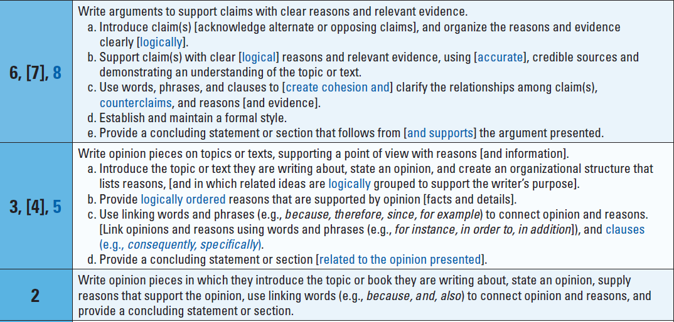
UTAH CORE Standard (WRITING) 1

Slide 8
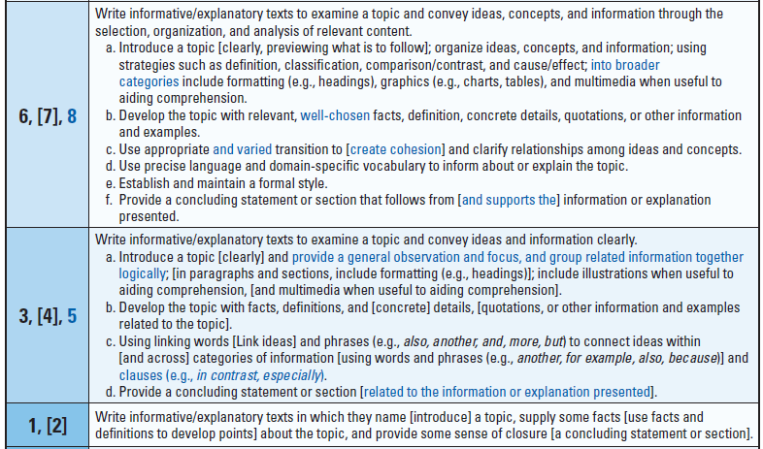
CCSS.W.2
UTAH CORE Standard (WRITING) 2

Slide 9
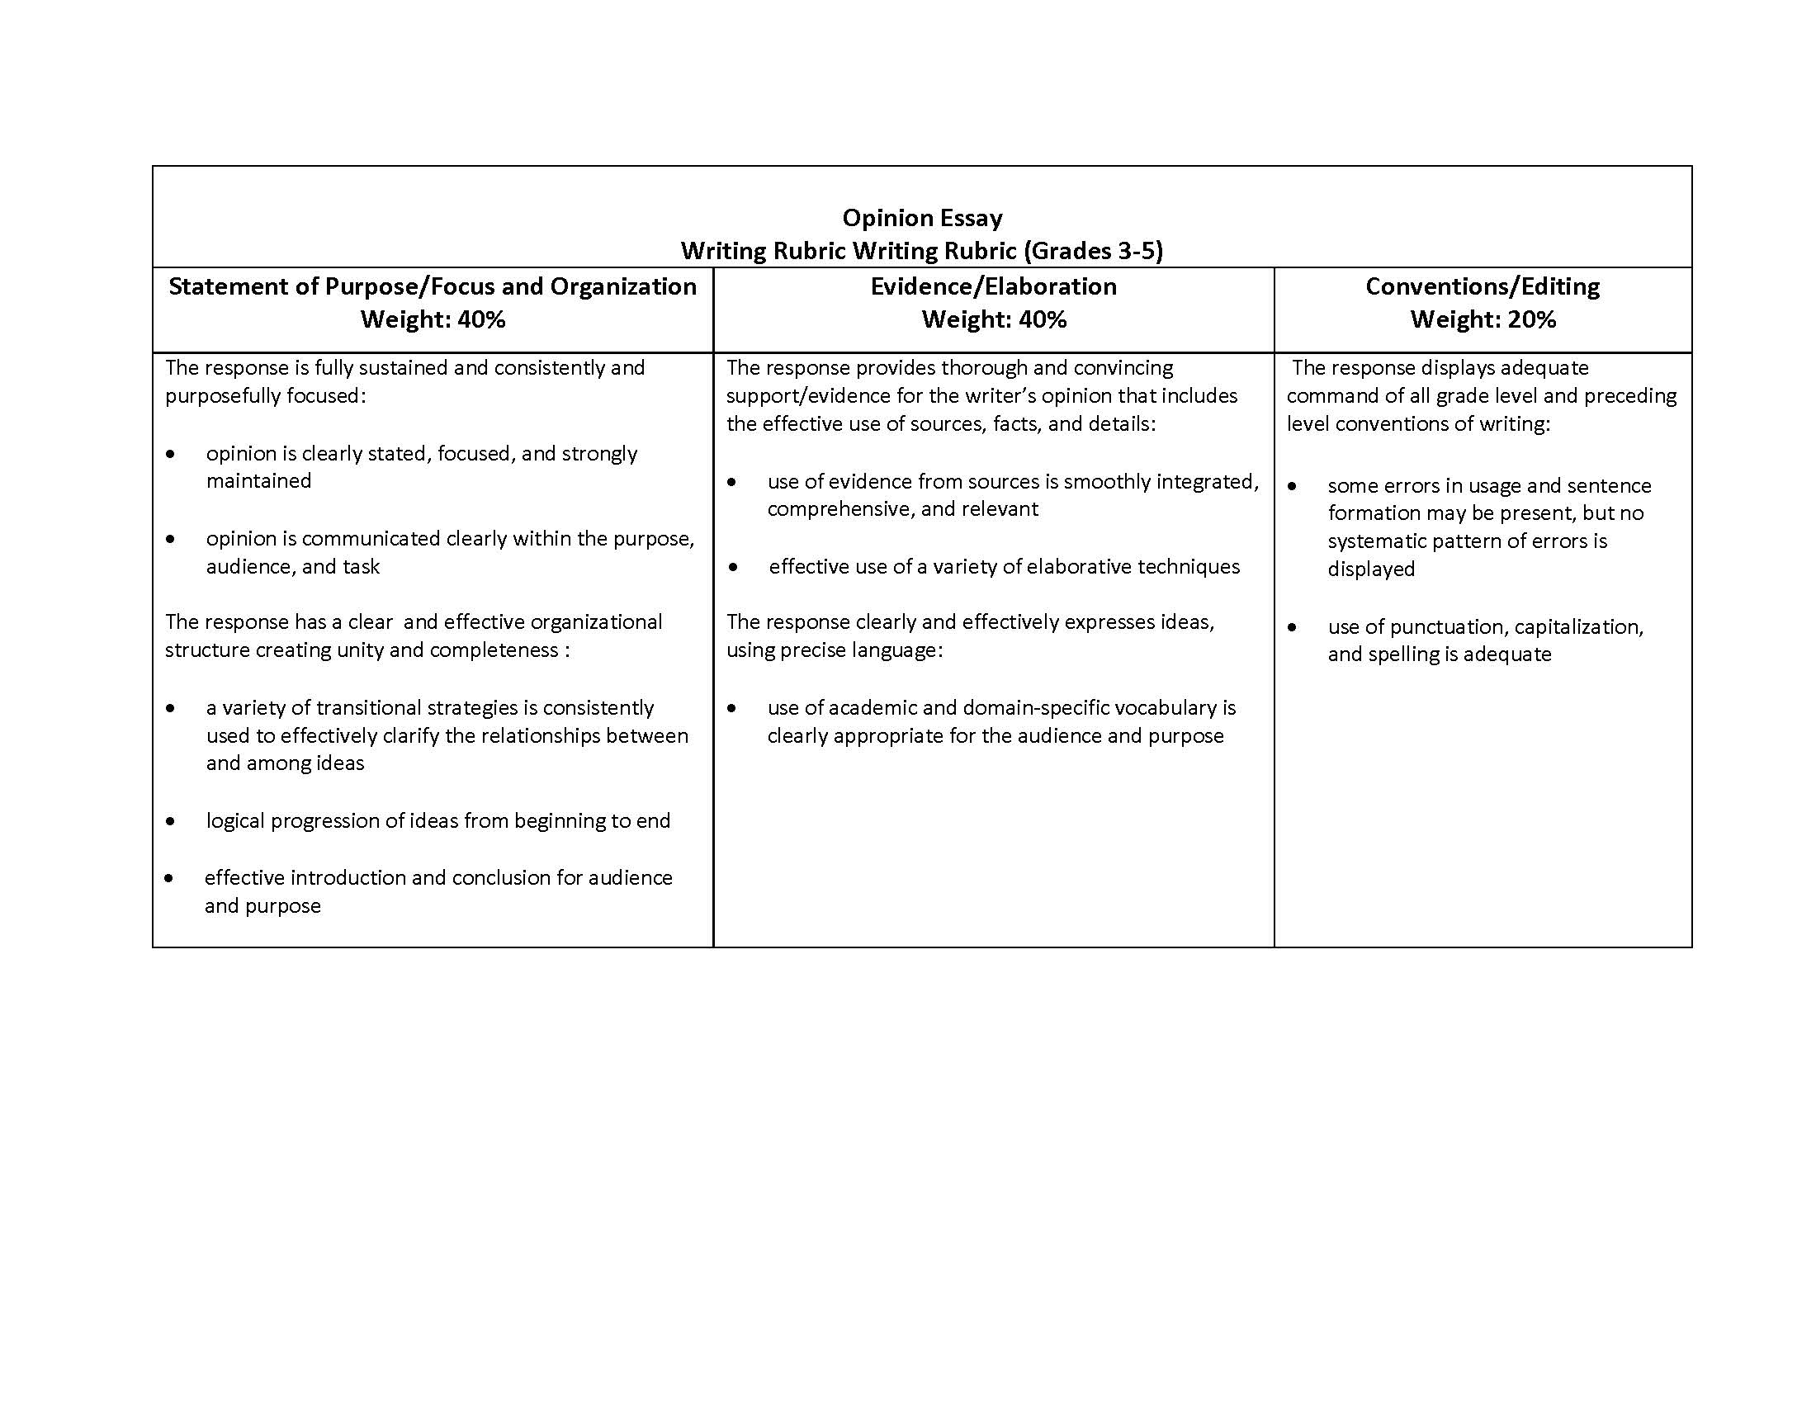

Slide 10
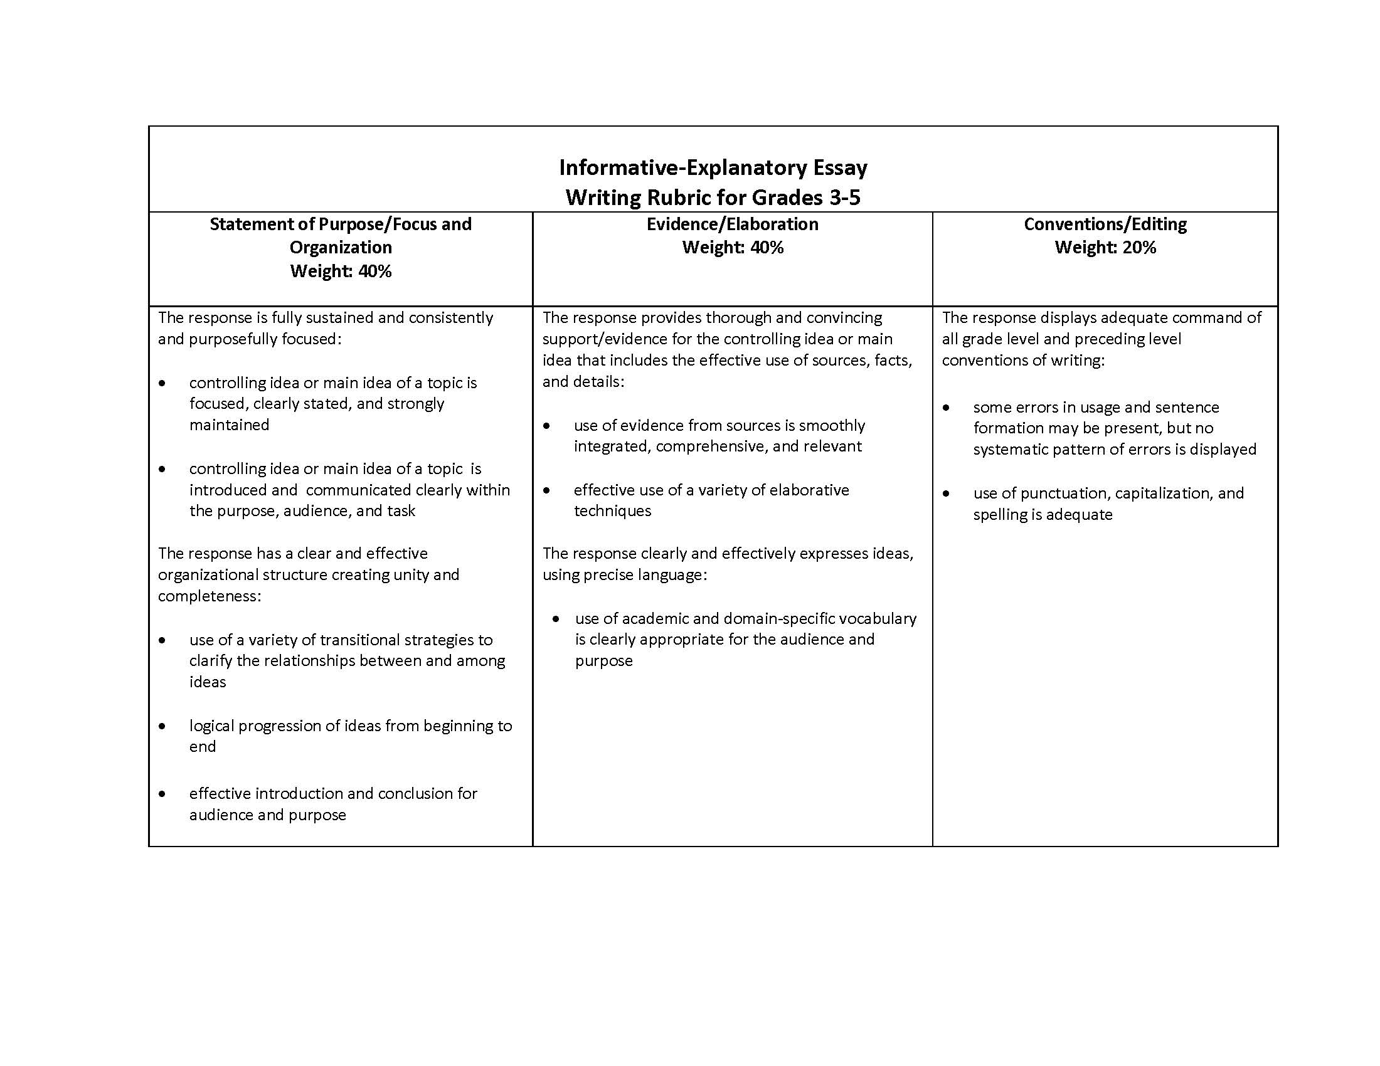

Slide 11
Writing about Tier I Text: How
Gradually reduce scaffolding to promote independence and automaticity
Guided organizer development
Guided drafting from organizer

Slide 12
FORI/QtA Text
Engagement
Writing
Scaffolding Drafting/Writing
Model text referencing to verify ideas
Model drafting
Scaffold responses/oral language
Model organization tools
Efficient instruction (routines and prompts)
Notes:
FORI +QtA= text comprehension scaffolding
Now we will adapt the instructional framework of Tier I Text that was used for scaffolding reading fluency and comprehension to scaffolding drafting/writing
Modeling organization—simplified student organizers
Modeling composition—shared writing—teacher models, students copycat
Modeling text referencing—using text navigation strategies to guide whole class back to evidence in text
Scaffolding responses—think-pair-share, forced choice
Efficient instruction—same routines each week (organizer, shared drafts), brief/consistent prompts (when returning to text, in choral responses, in choral spelling)

Slide 13
Writing about Tier I Text: when
In general…
  OUTSIDE of FORI 40 minutes of reading!!!!!
  After Day 1—in the afternoon
Organizer
  Part 1: Review on Echo/Deep Day
  Part 2: Review on Partner/Kid Comp Day

Slide 14
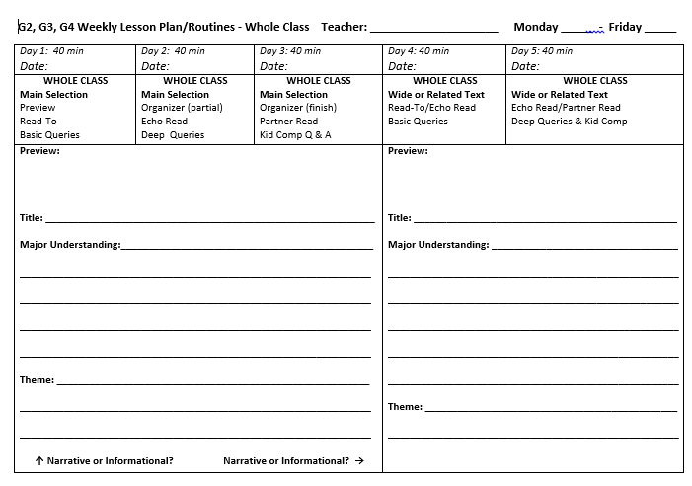

Slide 15
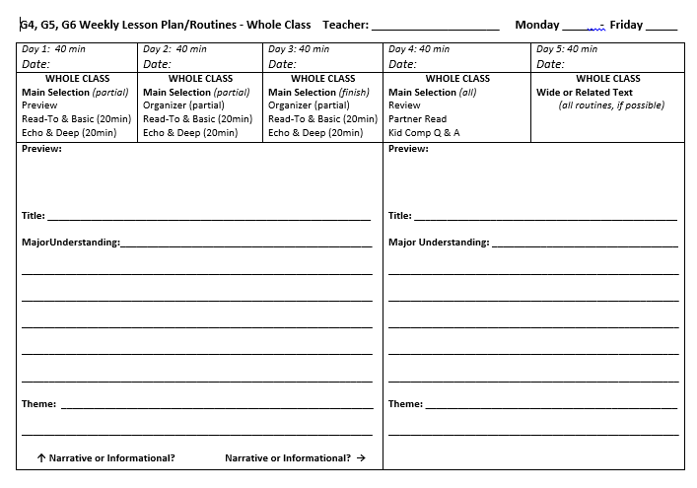

Slide 16
The next step…modeling drafting

Slide 17
Using an Organizer to Write About Informational Text
Use a document camera, the Organizer & Frame (see examples below) to model drafting in front of students.
Follow “frame” format
  Note: the frame is just an example; feel free to change, add-to, subtract-from, etc. with your grade level in mind.

Slide 18
Interactively, generate phrases. Students “copycat” your writing on their papers.
  This is important scaffolding for those who struggle composing written language.
Be explicit, but be sure to be interactive!
Lead students in chorally reading & re-reading what has been written.

Slide 19
Narrative Summary Frame
  Example:
  This ___genre/story is about... _______________(main character) and takes place in…___(time/place). The
  conflict (is/begins)……..
  But, ____(turning point)_____. The story ends with
  ____(resolution)___.
  The author uses this story to tell us that __(theme)___. In my opinion, the author is correct/not correct, because…..

Slide 20
Informational Frame…

Slide 21
2016-17 developments & refinements

Slide 22
Writing About Tier I Text
Training (Text type focus)
1. Overview SAGE State core Review Tier I Text routines Intro Kid Organizer
2. Explanatory/Informative Draft on Topic w/ Intro, Development, Conclusion based on 1 text (heaviest scaffolding) 1 paragraph
3. Explanatory/Informative Draft on Topic, Development, Conclusion based on 1 text (moderate scaffolding) 2-3 paragraphs
4. Explanatory/Informative Compare/Contrast, Development, Conclusion based on 2 texts (moderate scaffolding) Gradual Release of Organizer Sequencing & Drafting 2-3 paragraphs

Slide 23
5. Explanatory/Informative Draft on Topic, Development, Conclusion based on 1 text (moderate scaffolding) 2-3 paragraphs
6. Explanatory/Informative Compare/Contrast, Development, Conclusion based on 2 texts (moderate scaffolding) Gradual Release of Organizer Sequencing & Drafting 2-3 paragraphs

Slide 25
FORI/QtA Text
Engagement
Writing
Scaffolding Drafting/Writing
Model text referencing to verify ideas
Model drafting
Scaffold responses/oral language
Model organization tools
Efficient instruction (routines and prompts)
Notes:
FORI +QtA= text comprehension scaffolding
Now we will adapt the instructional framework of Tier I Text that was used for scaffolding reading fluency and comprehension to scaffolding drafting/writing
Modeling organization—simplified student organizers
Modeling composition—shared writing—teacher models, students copycat
Modeling text referencing—using text navigation strategies to guide whole class back to evidence in text
Scaffolding responses—think-pair-share, forced choice
Efficient instruction—same routines each week (organizer, shared drafts), brief/consistent prompts (when returning to text, in choral responses, in choral spelling)

