Slide 1
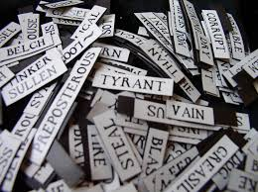
Keys to effective vocabulary growth
Margaret G. McKeown, Ph.D.
University of Pittsburgh
mckeown@pitt.edu
Margaret G. McKeown, Ph.D.
University of Pittsburgh
mckeown@pitt.edu

Slide 2
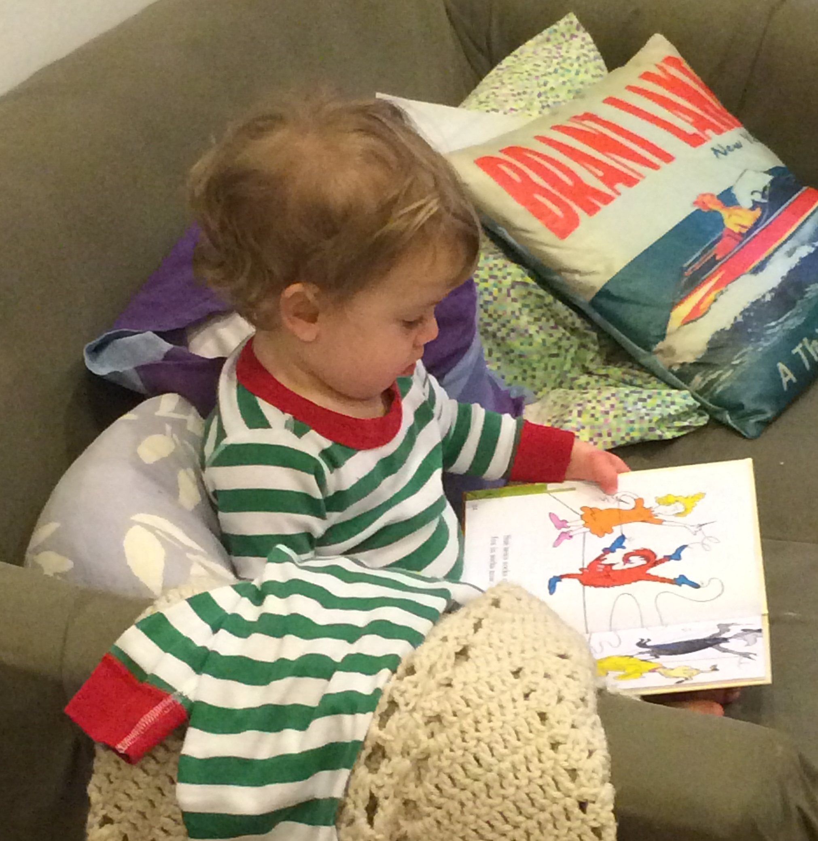
Effective Vocabulary Growth
Acquiring knowledge that supports comprehension

Slide 3
What’s needed for effective vocabulary growth
Multiple encounters – variety of contexts
Active processing – interactions around words

Slide 4
Focus: Interactions around words
Which words?
Examples of interactions
How interactions contribute to effective word knowledge
Evidence
Ideas for the classroom

Slide 5
Starting point: Which Words?
Fact 1: There are too many words to teach them all directly
Fact 2: Not all words in a language have the same utility
So – which words are most useful?
. . . Focus on words needed for text comprehension – Tier 2 words

Slide 6
Word Tiers: Tier 1
ier One:
the most basic words
mother, big, run, pull
words are concrete
children acquire them from conversation

Slide 7
Word Tiers: Tier 3
hree:
very low-frequency words, often limited to specific domains
molecule, tundra, axle
best taught within a content area

Slide 8
Word Tiers: Tier 2
general words that go across domains
consistent, function, supportive
characteristic of written language, i.e., text
Academic Word List (Coxhead, 2000)

Slide 9
A few examples
Academic/Tier 2 words →
analyze
fluctuate
inherent
consistent
duration

Slide 10
Multiple Encounters: Getting the ball rolling
Teresa was disappointed when Heather was her science lab partner because she didn’t know her very well. But it turned out that she and Heather were very compatible. They both were hard workers and liked to do their experiments carefully.
Friendly Definition:
When people or things are compatible, they work well together and get along with each other.
How does the meaning of compatible fit the context?

Slide 11

Following up
lots and lots of interactions around words!

Slide 12

Teacher: Can you use eavesdrop and gregarious in a sentence?
“If somebody reports you for talking, they’re eavesdropping and you’re gregarious!”

Slide 13

If I had a trillion dollars,
it would be
very complex to come up with an idea on what to spend it on. I would adopt a diverse group of kids from Africa, Asia, Europe, and India. I would also buy 2 domestic hedgehogs. I would send 1,000 dollars all over the world, which would be global. I would make an invention that integrates pizza and swimming. I will reside in Hawaii.

Slide 14
What’s so active?
Write a sentence using the word cozy
“I am cozy.”
My cat looks cozy when __________.

Slide 15

Interactions With Words
Generating contexts and uses
Integrating word meaning into context

Slide 16
Generating Contexts and Uses
TRIPLE THREAT: The goal for the class is to come up with at least three different ways to answer each question.
How could you decorate your bedroom if you wanted it to have a dramatic effect?
What would be an innovative way to give a history report?

Slide 17
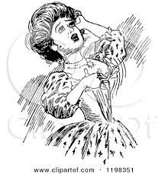
Integrating Word Meaning within Context
Mrs. Thomas was distraught when she looked at her garden.

Slide 18
How Integrating Works
bring to mind word meanings relevant to a context
fit together word and context
create an interpretation that makes sense
so that comprehension can proceed

Slide 19

. . . why??
“Why is singing your history report innovative?”
“Why would painting your bedroom black be dramatic?”

Slide 20
Integrating Word and Context:
Words with Multiple Senses
If you put solar panels on your roof to generate your home’s electricity, what does that mean?
If the solar panels generate a lot of interest in your neighborhood, what does that mean?

Slide 21
Integrating Word and Context :
How different words affect a context
“What’s the difference?”
Situation: Michelle is going to do a hip hop routine in the student talent show.
To make her hip hop routine dramatic, she ______________.
If her hip hop routine is unique, it ___________________.

Slide 22
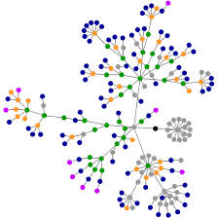
Interactions ➔ effective word knowledge
Knowledge of a word grows each time you encounter it in a new context
Connections from word →other words → familiar experiences

Slide 23
As Network Grows Richer
A generalized understanding of the word develops
So you avoid:
being stuck with a narrow concept of a word
having disconnected ideas of what a word means

Slide 24

For example . . .
a narrow concept →
“trend”
  What’s a political trend? What politicians are wearing!?

Slide 25
For example . . .
separate, disconnected ideas →
  An artist seeks objects that have “potential to become a work of art.”
  Home owners seek “potential house-buyers.”
  being able to unite those ideas of potential → possibility of becoming or happening in the future.

Slide 26
Goal: rich & generalized understandings of word meaning
Allows speed and flexibility when making sense of a new context
Speed – the reading process won’t have to slow down
Flexibility – you can make sense of a new use of the word

Slide 27

Result!
Getting to the meaning faster, and being flexible means that your comprehension will be successful.

Slide 28
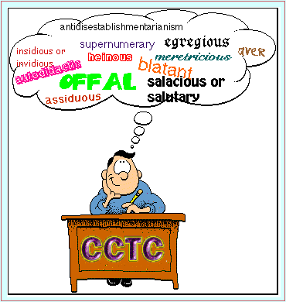
The Evidence
Skilled readers have “abundant high quality” understandings of words relative to less skilled readers

Slide 29

The Evidence
Skilled comprehenders are better at integrating word meaning and context

Slide 30
Evidence from Instructional Interventions
Interactions around multiple, varied contexts → comprehension gains
Mezynski, 1983
Stahl & Fairbanks, 1986
McKeown, Beck, Omanson, & Pople, 1985
Margosein, Pascarella, & Pflaum, 1982
Bos & Anders, 1990; 1992
Medo & Ryder, 1993
Dole, Sloan, & Trathen, 1995

Slide 31

Interaction is powerful
  It takes a lot of effort learn a new word – incremental
  Encourage robust talk in classrooms

Slide 32
Find opportunities to keep attention on new vocabulary
Start the day:
“Today is Tuesday. Let’s get inspired!”
“Was anyone reluctant to get out of bed this morning?”
Incorporate into lessons:
“Do you see any of the characters in the story as manipulative?”

Slide 33
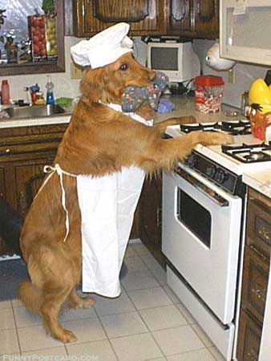
Pictures That are Worth 1,000 Words
Rex had an uncanny way of letting his owners know he didn’t want canned dog food.
Rex’s hapless owner had forgotten to buy dog food—again.

Slide 34
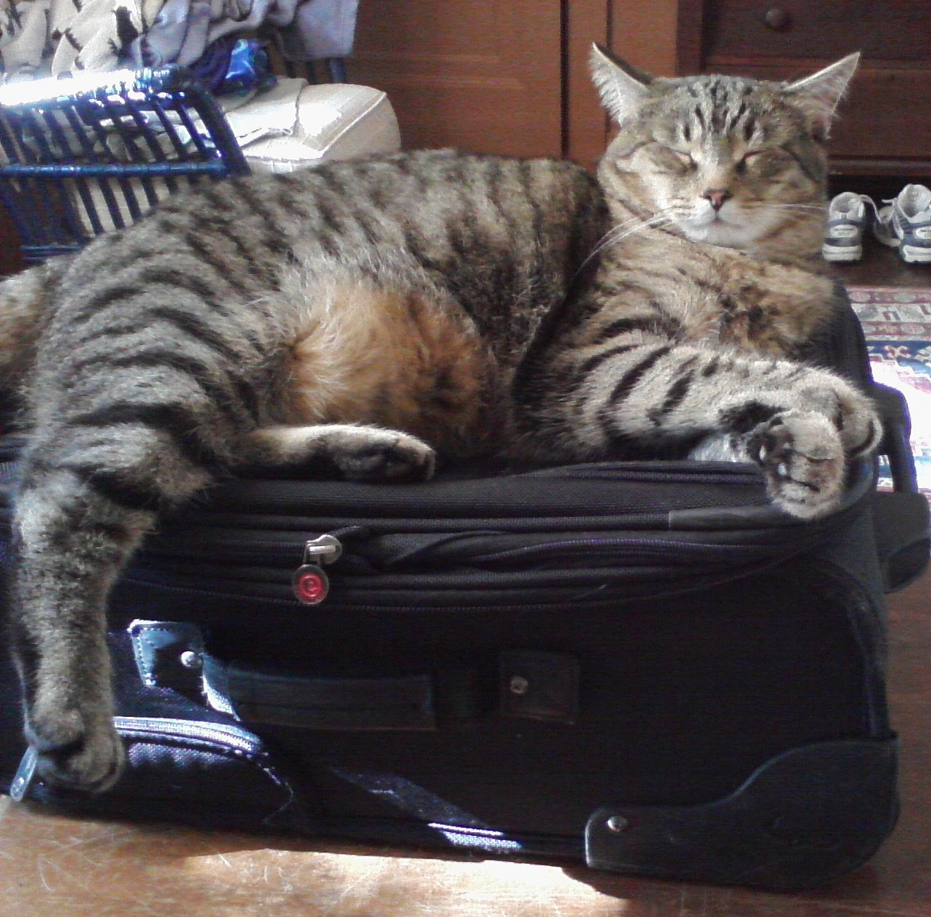
Pictures That are Worth 1,000 Words
Have you heard? The latest trend is taking your cat on vacation.
My definitive answer is – You’re not going anywhere.

Slide 35
Beyond the Classroom
Challenge students to find their words outside of school:
in books, websites, newspapers, billboards, bus ads, radio, television, video games, magazines, menus, music, etc.
Tally points on a classroom chart – make it public and motivating!

Slide 36
Effects of Extending Vocabulary
Word Wizard – greater advantage for comprehension (4th graders)
In the Media - A significant, positive relationship between taking part and students’ gain scores from pretest to posttest (6th graders)

Slide 37
Take Home Message
For successful vocabulary growth: Give students –
lots of ways to interact with words
in and out of the classroom!

Slide 38

Thank you!

