Slide 1
Repeated readings
What can we learn from eye movements?

Slide 2
Dr. kathleen j. brown
University of utah reading clinic
www.uurc.org

Slide 3
Repeated readings: basics
Multiple readings of same text, either to a criterion or 4x
Goal = to improve fluency, with end goal of improving comprehension
Grounded in decades of theoretical & empirical research: Huey, 1908; LaBerge & Samuels, 1974; NRP, 2000; Zawoyski, Ardoin, & Binder (2015), Reading Research Quarterly, 50. 171-184.

Slide 4
Repeated readings: research
Multiple readings of same text benefit:
  Skilled readers (children & adults)
  Readers with learning disabilities
  All students through G4 (d = .83 for fluency; d = .67 for comprehension)
Gap = Does RR have differential effects for different ability groups?

Slide 5
Methods - participants
Started with 99 students in G2; ended up with 44.
Dropped 55 students who skipped parts of the text.
Non-Title I, suburban public school; middle of year (ORF benchmark = 72 wcpm)
22 Lower-Performing median ORF = 74 (SD = 13)
22 Higher-Performing median ORF = 144 (SD = 22)
Significant differences between LP and HP (p < .001) on W-J3 Reading

Slide 6
Methods - participants
If ORF MOY benchmark = 72 wcpm, the term “lower-performing” is misleading. Therefore:
Lower → Average-Performing median ORF = 74 (SD = 13); WJSS = 106
Higher-Performing median ORF = 144 (SD = 22); WJSS = 117

Slide 7

Methods – eye movements
Eyes make quick, jumping movements across text.
Jump = Saccade; Pause = Fixation
Backward Jump = Regression
Regressions can be intraword or interword.

Slide 8

Methods – eye tracker
Students placed chin on chin rest; read from computer screen
High resolution camera on desktop, in front of screen
Students pushed a key to show they had finished reading & to answer a comprehension question.

Slide 9
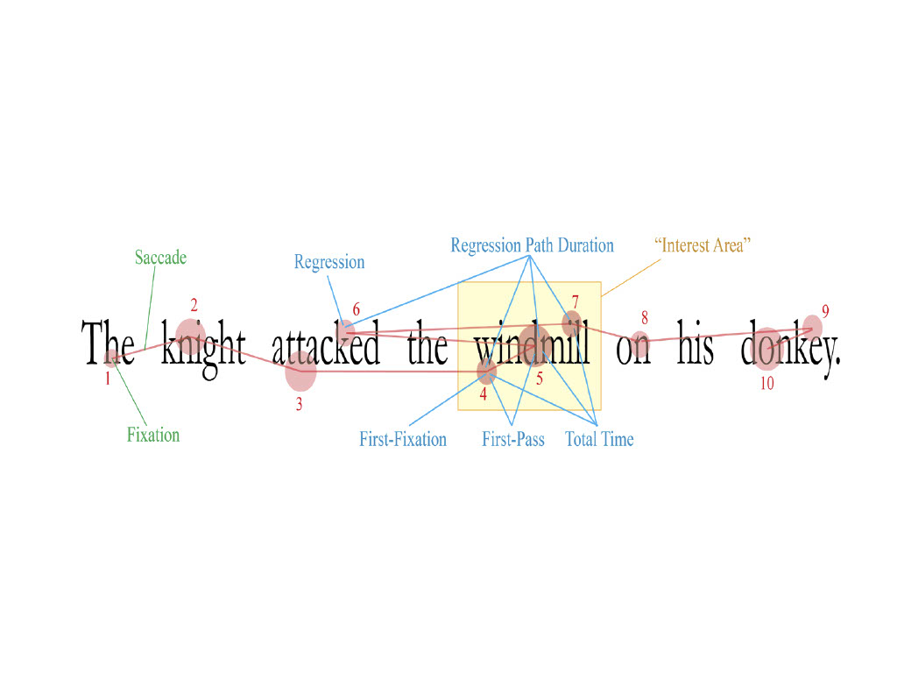

Slide 10
Methods – measures
First fixation duration time
Gaze duration time
Number of intraword regressions
Total fixation time
Number of interword regressions
Average fixation count per word
HYPOTHESIS: all measures should decrease across re-readings.

Slide 11
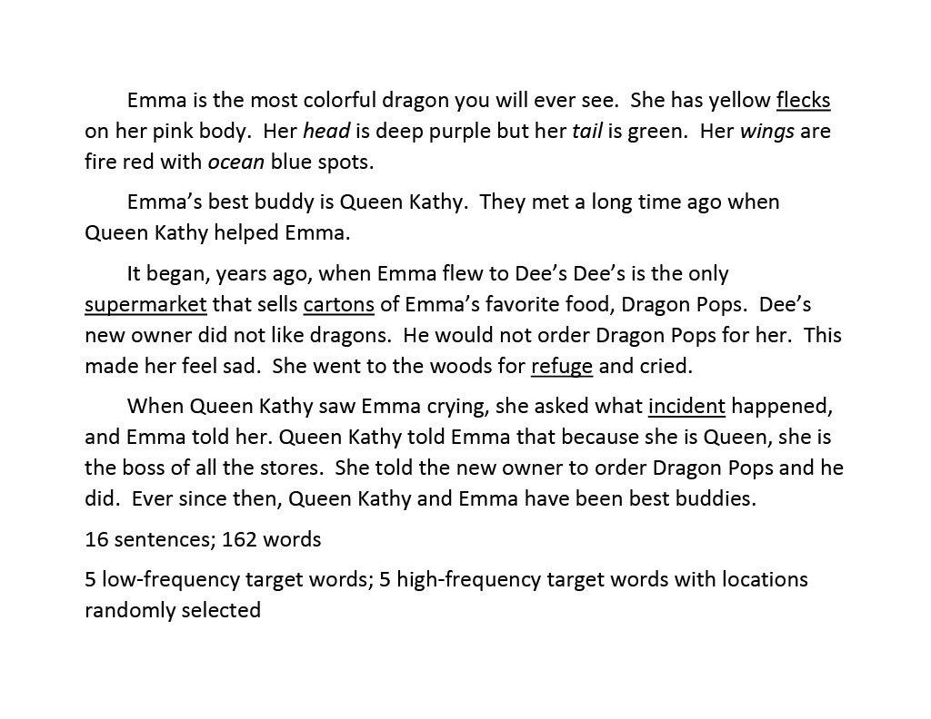
Methods - materials

Slide 12
Methods - procedures
Each student read same passage 4x in 1 session.
Answered comprehension question (encourage attention to meaning)
Received feedback about reading time (encourage motivation)
No time limit (breaks allowed for fatigue)

Slide 13
Methods – effects criteria
Cohen’s d indicates the standardized effect size between two means—in this study between pairs of readings
  small = .2
  medium = .5
  large = .8

Slide 14
Results - global
HP readers consistently outperformed AP readers.
RR benefited HP (d = 1.58) and AP readers (d = 1.08) from R#1 → R#4.
R#2 benefited HP readers (d = 1.05) more than AP readers (d = .60).
R#3 benefited AP readers (d = .83) more than HP readers (d = .46).
R#4 was not significant on any measure for either group.

Slide 15
Results – global
RR positively impacted early processing (word id) and late processing (comprehension) of text for both HP and AP readers.
HP and AP readers improved on early and late processing from R#1→R#2.
Both groups continued to improve on late processing from R#2→R#3.

Slide 16
Results – Target words
RR helped both HP and AP readers reduce time spent on low-frequency words.
RR also helped AP readers reduce time spent on high-frequency words.
Floor effect for HP readers on high-frequency words from R#1→R#4.

Slide 17
Implications for practice
Repeated Readings benefit both Higher-Performing and Average-Performing Readers.
Reading a text 3x may be enough for these students during 1 session.
It took 3x for AP readers to match HP readers’ 1st trial. (Need for scaffolding, such as listening?)

Slide 18
limitations
This study’s “lower-performing” readers are really “close-to-benchmark” readers. Need to conduct study in Title I schools!
Passage was at lowest kids’ instructional level. Need to vary text difficulty levels!
RR only occurred during 1 session. Need to vary number of sessions!

