Slide 1
Tiers II and III
The Principal’s Guide
Dr. Kathleen J. Brown
University of Utah Reading Clinic
January 23-24, 2014
www.uurc.org
kathleen.brown@utah.edu

Slide 2
What Causes Reading Difficulties?
Reading Difficulties are
<--------------------------------------------------------->
Constitutional and/or Environmental
(in the kid) (outside the kid)
Brainstorm with a colleague: What are some examples of constitutional & environmental causes of reading difficulties that you have observed?

Slide 3
Research Questions:
Are there profiles of struggling readers?
  Good Decoders w/Poor Reading Comprehension a.k.a. “Word Callers”
  Good Reading Comprehenders w/Poor Decoding a.k.a “BK Compensators”
  Students who struggle with BOTH decoding & comprehension
Are any profiles more prevalent than others?
Shankweiler et al., (1999). Scientific Studies of Reading.

Slide 4
Methods
Call went out for “kids with learning problems”
N = 361 students ages 7.5-9.5 w/IQ >80
Measures = reading comp, word id, pseudo word id, listening comp, etc.
plotted composite reading scores on scattergram

Slide 5
Results
n = 114 students = average or above readers
n = 71 students = too close to call (buffer zone)
Remaining students = poor readers
n = 127 n = 32 n = 17
Draw a quadrant. Where do you think each group of poor readers is located?

Slide 6
Results
n = 127 = equally poor at decoding & comp
n = 32 = better reading comp scores than decoding scores (Dyslexics)
n = 17 = better decoding scores than reading comp scores(Word Callers)

Slide 7
Take-Home Message for Principals
Most children are equally good or poor at both decoding & comp (n = 241 of 361 or 67%).
There are a few “discrepant readers” (n = 49 of 361 or 14% of total population).
There are very few Word Callers (n = 17 of 176 or 10% of total poor readers)
It is a stretch to label these students Word Callers. Even though they are relatively better at decoding than at comp, they are still lower on average than good readers at either.

Slide 8
Take-Home Message for Principals
The vast majority of poor readers demonstrate deficits in decoding skills (159 of 176 or 90% of poor readers)
High quality decoding instruction is necessary!
Miles on the page are necessary!
Neither is sufficient on its own!!!

Slide 9
Let’s Build Some Background…
Why is reading so easy for good readers?
Why is reading so hard for poor readers?
Let’s look at the research!

Slide 10
When I walked into the Hall of Mirrors, I saw phantasmagoria happen with my own body.
“Kathleen,” my husband said, “No one would ever accuse you of being breviloquent!”
How did you identify/pronounce this word?
How did you figure out what it means?

Slide 11
black green black
green red green
black black red
red red blue
blue blue
red black
black green
green blue
red green

Slide 12
Representation in the Mind
Phonological rep = sound
Semantic rep = meaning
Orthographic rep = spelling
all 3 working in parallel → automatic word recognition
bat

Slide 13
Expert Reading=Word Rec X Comp
Comprehension is both Automatic & Strategic
  accurate, fast, effortless
  know how to troubleshoot
  flexible
  persistent
Word Recognition is Automatic
  accurate
  fast
  effortless
(Adams, 1990; Gough & Tunmer, 1986; Rayner, Foorman, Perfetti, Pesetsky, & Seidenberg, 2001)

Slide 14
He had never seen dogs fight as these wxxxish cxxxxxxxx fxxxxt, and his first exxxxxxxxx txxxxt him an unfxxxxxxxble lxxxxx. It is true, it was a vixxxxxxx exxxxxxxxx, else he would not have lived to prxxit by it. Cxxxx was the vxxxxx. They were camped near the log store, where she, in her friendxx way, made adxxxxxx to a husky dog the size of a full-xxxxx wolf, thxxxx not half so large as xhe. Thxxx was no wxxxing, only a leap in like a flash, a metxx clip of teeth, a leap out exxxxly swift, and Cxxxx’s face was ripped open from eye to jaw.

Slide 15
Novice Reading=Word Rec X Comp
Comprehension is both Automatic & Strategic
  accurate, fast, effortless
  know how to troubleshoot
  flexible
  persistent
Word Recognition is Necessarily Strategic
  often inaccurate
  slow
  effortful
(Adams, 1990; Rayner, Foorman, Perfetti, Pesetsky, & Seidenberg, 2001)

Slide 17
Who Delivers Reading Intervention?
Struggling readers’ difficulties range from mild to moderate to severe.
Depending on resources, your SPED personnel will serve moderate to severe. This = Tier III intervention (IEP required for certain %age).
Depending on resources, your regular ed and/or Title I personnel will serve mild to moderate. This = Tier II intervention.
Who delivers Tier II and Tier III reading intervention in your school? Is there adequate coverage?

Slide 18

Effective Tier II & III
Reading Intervention is…
Explicit
Systematic
Cumulative
Sequential and Incremental
Paced by Data

Slide 19
Effective Tier II & III
Reading Intervention includes…
Assisted reading at instructional level
Word Study (P.A. phonics, spelling)
Fluency Work
All of the above needs to be paced via data as fast as the child can go!!!! There is not a moment to waste!!

Slide 20
Tier II Basic Intervention
Should include key components (assisted reading + word study + fluency work)
At least 2x weekly for 45 minutes (more is better & more may be needed!)
Delivered by someone who has been trained
Supervised by Literacy Coach and Classroom Teacher who use progress-monitoring data to pace!!!
Here are some examples: Early & Higher Steps

Slide 21
Tier III Intensive Intervention
Should include key components (assisted reading + word study* + fluency work*)
At least 4x weekly for 60-90 minutes
Delivered by someone with strong expertise
Supervised by Literacy Coach and SPED Teacher who use progress-monitoring data to pace!!!
Examples: Orton-Gillingham, Wilson, Lindamood Bell, Barton, Alphabetic Phonics, etc.

Slide 22
Identifying Reading Disability in Utah
Utah Schools may use any of the following options:
A. Response to Intervention
B. Discrepancy (1.5 s.d.) between reading achievement & intellectual ability - e.g., IQ = 100 WRMT = 78
C. Combination of A & B above
Which method does your school use? How well is it working for students, parents, teachers, you?

Slide 23
Types of Tier III Struggling Readers
Slow learners (don’t qualify w/discrepancy method)
Students with moderate to severe communication disorder (fewest)
Students with moderate to severe dyslexia (most common)
Note: these issues do not go away! They are ‘womb to tomb.’ However, with enough of the right intervention, students can improve!

Slide 24
Tier III Slow Learners
Well below grade level in both reading and math—even after good classroom instruction & intervention
Do not present with a discrepancy between ability and achievement
Need basic Tier II Intervention but more often!
  Double hits per day, or
  5 days per week
Your experiences with this type of student?

Slide 25
Tier III Communication Disorder
Difficulties in learning/using language, caused by problems with vocabulary, grammar, and putting sentences together in a good way.
Problems can be receptive (understanding language) and/or expressive (producing language)
Not to be confused with articulation problems!
Need identification & specific, intensive , frequent language intervention from an SLP
Your experiences with this type of student?

Slide 26
Tier III Dyslexia
Dys = difficulty Lexia = words
Many misconceptions (e.g., seeing backwards, colored lenses, marching, eye training)
Core deficit = phonological system (i.e., significant problems matching speech sounds to letters) results in poor fluency, spelling, word recognition
Math and oral language often are normal or above
Your experiences with this type of student?

Slide 27
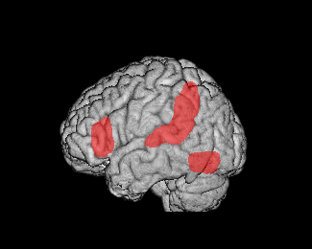
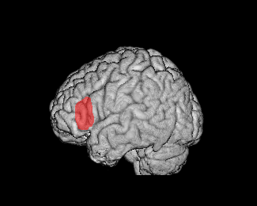
Neurobiological Basis of Dyslexia
Typical Readers
Dyslexic Readers
Eden et al., Neuron, 2004

Slide 28
The Heart of the Problem
Understanding the alphabetic principle and mastering all sound-symbol correspondences.
/ch/
ch
tch

Slide 29
Dyslexia
Dyslexia
- is a language-based problem, not a visual problem; dyslexics do not see things backwards.
- exists across all levels of intelligence
- is not caused by lack of motivation
- all socioeconomic levels
- slightly more boys than girls
- may occur in spite of good classroom
instruction & is resistant to intervention
- may occur with other disorders (e.g., ADD)

Slide 30
Utah’s SLD Definition
Dyslexia
A disorder of one or more of the basic psychological processes involved in understanding or in using language, spoken or written, that may manifest itself in the imperfect ability to listen, think, speak, write, spell or do mathematical calculations such as perceptual disabilities, brain injury, minimal brain dysfunction, dyslexia and developmental aphasia, that affects a students’ educational performance.
A specific learning disability does not include learning problems that are primarily the result of visual, hearing, or motor disabilities; or intellectual disability; of emotional disturbance; or of environmental, cultural, or economic disadvantage.
—USOE Specific Learning Disability Definition (&300.8©(10)), which relies on the federal definition of a specific learning disability (SLD). May 2, 2013.

Slide 31
IDA’s Dyslexia Definition
Dyslexia
Dyslexia is a specific learning disability that is neurobiological in origin. It is characterized by difficulties with accurate and/or fluent word recognition and by poor spelling and decoding abilities. These difficulties typically result from a deficit in the phonological component of language that is often unexpected in relation to other cognitive abilities and the provision of effective classroom instruction. Secondary consequences may include problems in reading comprehension and reduced reading experience that can impede growth of vocabulary and background knowledge.
—Lyon, G.R., Shaywitz, S. E., Shaywitz, B.A. (2003). A definition of dyslexia. Annals of Dyslexia, 53, 1-14.

Slide 32

How Many Dyslexic Students?
80-85% of students with an identified specific learning disability (SLD) have a primary problem with reading and/or language
10-20%, or 1 out of every 5-10 students, has symptoms of dyslexia
—National Institute of Child Health and Human Development (2003)

Slide 33
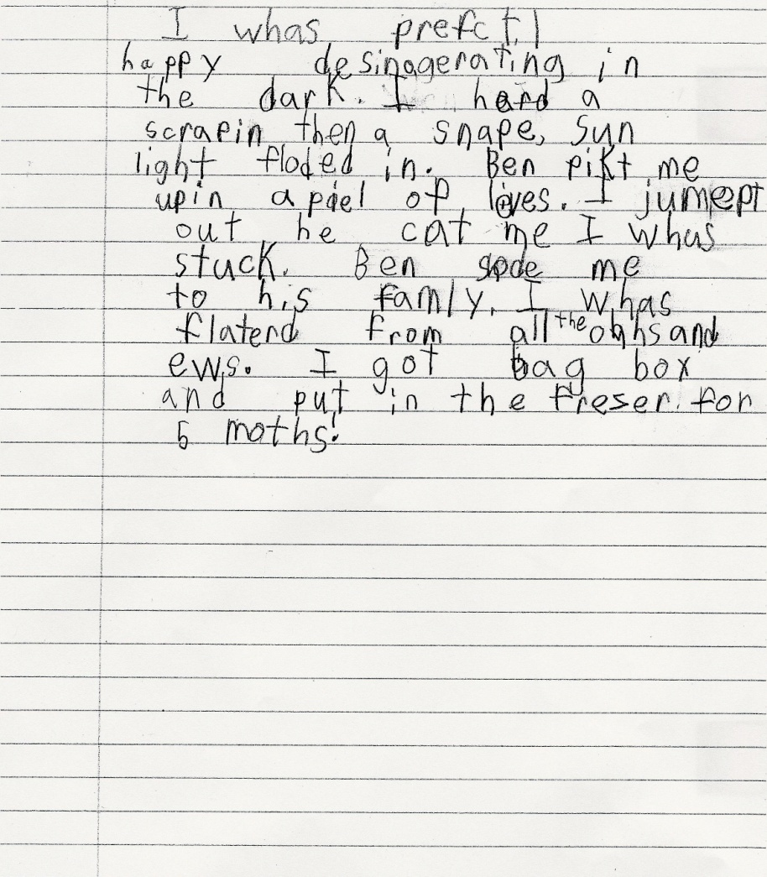
4th grade writing sample
I was perfectly happy disintegrating in the dark. I heard a scraping then a snap, sunlight flooded in. Ben picked me up in a pile of leaves. I jumped out he caught me I was stuck. Ben showed me to his family. I was flattered from all the ahhs and oohs. I got bagged, boxed and put it in the freezer for 5 months.
Review the symptoms of dyslexia.
Evidence that this student is dyslexic?
Additional evidence needed?
Notes:
Basic Facts Overview Presentation
1/26/2014
33

Slide 34
What is Dyslexia?
1. Work with a partner to flesh out a semantic web that summarizes dyslexia as defined in Utah and by the IDA.
2. Use key words, not complete sentences.
3. You have 7 minutes to complete this task.

Slide 35
Spreading Accurate Info about Dyslexia
Scenario #1:
A --- You are a veteran teacher who has been searching on-line for reading intervention ideas. You are excited by claims of a “research-based cure” for dyslexia. Try to convince your principal that s/he needs to spend building funds to purchase colored lenses for struggling readers.
B ---- You are a principal. Use your knowledge about dyslexia to tell the teacher, “No.”

Slide 36
Spreading Accurate Info About Dyslexia
Scenario #2:
A --- You are a district administrator who is tired of being brow-beaten by parents of struggling readers. You are about to issue a district policy that forbids teachers and administrators from using the term ‘dyslexia’ in discussions with colleagues, parents, and students because it is too vague.
B ---- You are a principal. Use your knowledge about dyslexia to tell the administrator this is not consistent with state policy or research.

Slide 37
Take-Home Message for Principals
We can’t assume a child is Tier III (has a disability) w/out trying Tier II intervention.
Constitutional deficits show up early. Assess & intervene in Kindergarten!!
The discrepancy formula is not enough. We also need to look at response to intervention.
Intervention can reduce the “LD” population!

Slide 38
Take-Home Message for Principals
For students with moderate reading difficulties who do not have IEPs, and who are unlikely to qualify for an IEP, a 504 Plan can be a life-saver!
A 504 Plan will allow accommodations that help a junior high/high school student to keep up with coursework and demonstrate optimum performance on standardized tests (e.g., ACT)
Teachers need to be in the 504 “loop” for the plan to work well. A 504 Plan is not “cheating!”

Slide 39
Definition of Terms
Phoneme: An individual speech sound. (/sh/, /ŏ/, /p/)
Grapheme: A letter or letter group that represents a speech sound or phoneme. (sh – o – p)
Morpheme: The smallest linguistic unit in a word that has meaning. (shop + ed)

