Slide 1


Language and literacy for young learners seminar phonological Awareness
Lisa Reed, Brynnli Paulsen, Wendy Wittwer
Intervention Specialists
University of Utah
Spring 2017

Slide 2


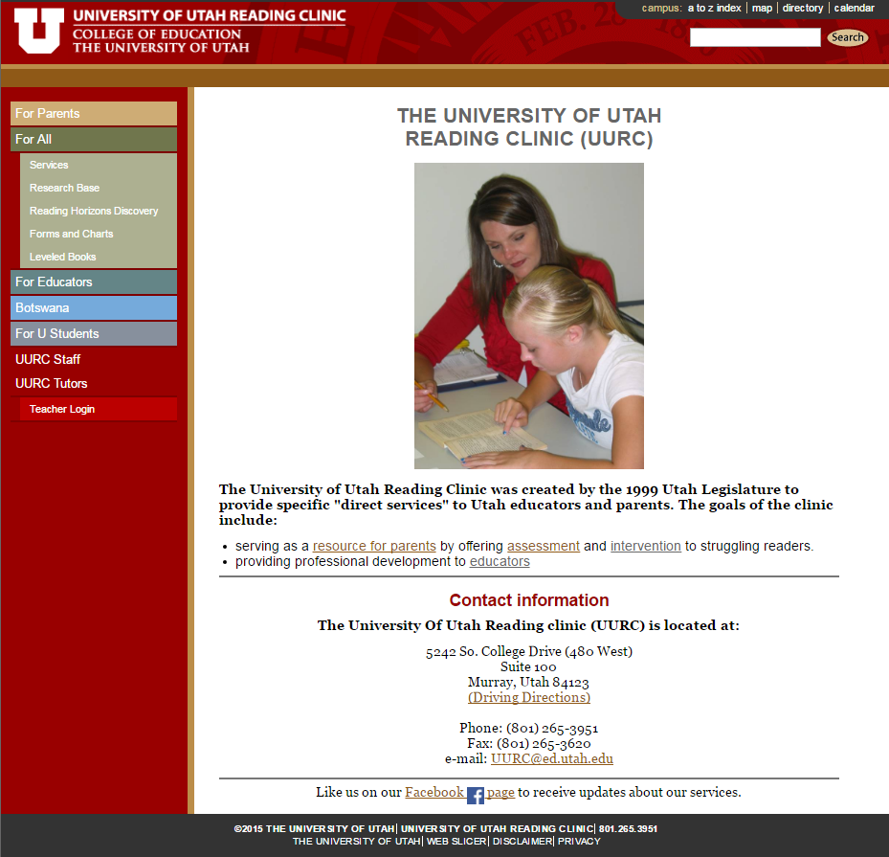
Professional development for educators
Research-based intervention
Developmentally appropriate
www.uurc.utah.edu

Slide 3
Phonological Awareness:
Introduction/Overview
Empirical Research
Educational Standards & Guidelines
Overview of Phonological Awareness
Diagnostic Assessment/Instruction
Activities
Planning
Follow-up Assignment
Questions/Reflection

Slide 4
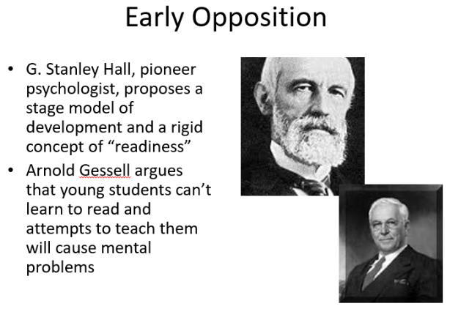
The acquisition of children’s reading skills was once thought to originate with the start of reading instruction in elementary school.
Notes:
.

Slide 5

Top Predictors of G1 Reading Success
health
IQ
knowledge of letter names
oral language ability
socio-economic status (SES)
phonemic awareness
gender
print awareness
amount of time parents read to child
(see Adams, 1990, Moats, 2003 for extensive reviews)
http://www.uurc.utah.edu/Educators/Videos-Seminars.php

Slide 6

Research says . . .
Research now supports the idea that children learning to read is a continuous developmental process that emerges early in life (Lonigan, 2006; Snow, Burns, & Griffen, 1998, Whitehurst & Lonigan, 1998).
Children’s reading success throughout elementary school can be predicted from their emergent literary skills (Lonigan, Burgess, & Anthony, 2000; Lonigan, Schatschneider & Westburg, 2008, Spira & Flischel, 2005, Storch & Whitehurst, 2002).
Phonological Awareness is strongly related to the acquisition of reading (Perfetti, Beck, Bell, & Hughes, 1987; Wagner, Torgeson, & Rashotte, 1994).
Children who are able to detect increasingly smaller units of sound are more capable of breaking the alphabetic code (i.e., that the letters in print reflect the specific sounds in spoken words; Adams, 1990; Whitehurst & Lonigan, 1998).
Shauna B. Wilson & Christopher Lonigan; An Evaluation of Two Emergent Literacy Screening Tools for Preschool Children, published online Oct. 2009

Slide 7
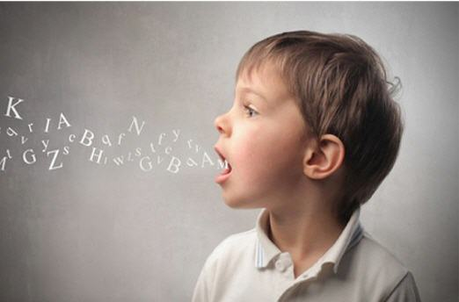
What is Phonological awareness?
Awareness of the phonological segments in speech that are more or less represented by the letters of the alphabet
LINK between Speech and Print achieved over time failure to develop this awareness is a major stumbling block in reading acquisition (Road to the Code, Blachman B., Ball E., Black R., & Tangel, D. (2000)
Research shows- Toward the goal of efficient and effective reading instruction, explicit training of phoneme awareness is invaluable -Adams, 1990

Slide 8
National Early Learning Panel (NELP)
6 Variables Strongly Correlated with Later Literacy
2008
  Alphabet Knowledge
  Phonological Awareness
  Rapid Automatic Naming
        letters and digits
  Rapid Automatic Naming
        objects and colors
  Writing or Writing Name
  Phonological Memory
These 6 variables not only correlated with later literacy… but maintained their predictive power even when the role of other variables were accounted for.

Slide 9
Guidelines For Learning
Utah’s Early Childhood Core Standards - Phonological Awareness
Preschool Foundational Standards
a. Respond to the rhythm of spoken language, such as songs, poems, or chants.
b. Begin to recognize syllables (word parts) in simple words.
c. Begin to recognize initial sounds in words (e.g., own name).
d. Begin to demonstrate understanding the concept of first, middle and last.
With guidance and support, begin to identify sounds (phonemes) in spoken words
Notes:
Our road map is our Utah Core Standards They are a result of empirical research and the collaboration of many educational experts in the State of Utah. Adopted in 2010 for elem.-through secondary, the Early Childhood Standards were added by 2011.
As for PA, you see the foundational skills that are key for PreK students to achieve future success.

Slide 10
Guidelines For Learning
Utah’s Early Childhood Core Standards - Phonological Awareness
Kindergarten Readiness Standards
With guidance and support, identify and discriminate between sounds (phonemes) in spoken language, such as attention to beginning and ending sounds (phonemes) in words.
a. Begin to supply rhyming words in
familiar songs/ jingles and orally match
words that rhyme.
b. Identify and separate syllables (word
parts) in words.
c. Identify words by syllables, beginning
sounds, or individual sounds.
d. Recognize initial and final sound of
words.
e. With modeling and support, identify
individual phonemes (e.g., /d/, /s/, /t/).

Slide 11
Guidelines for Learning
Head Start Early Learning Outcomes Framework – Phonological Awareness
Developmental Progression ⇨ 48-60 Months
Indicators ⇨ By 60 Months
Provides one or more words that rhyme with a single given target, such as “What rhymes with log?”
Produces the beginning sound in a spoken word, such as “Dog begins with /d/.”
Provides a word that fits with a group of words sharing an initial sound, with adult support, such as “Sock, Sara, and song all start with the /s/ sound. What else starts with the /s/ sound?”
Demonstrates rhyme recognition, such as identifying which words rhyme from a group of three: hat, cat, log. Recognizes phonemic changes in words, such as noticing the problem with “Old McDonald had a charm.” Is able to count syllables and understand sounds in spoken words.

Slide 12
Building the Foundation
Sentence and word awareness
Rhyming and alliteration
Syllable awareness
Onset and rime manipulation
Phoneme awareness
“Phonological skill develops in a predictable progression. This concept is important, as it provides the basis for sequencing teaching tasks from easy to more difficult.”
(LETRS Module 2, Louisa C. Moats, Ed.D)

Slide 13
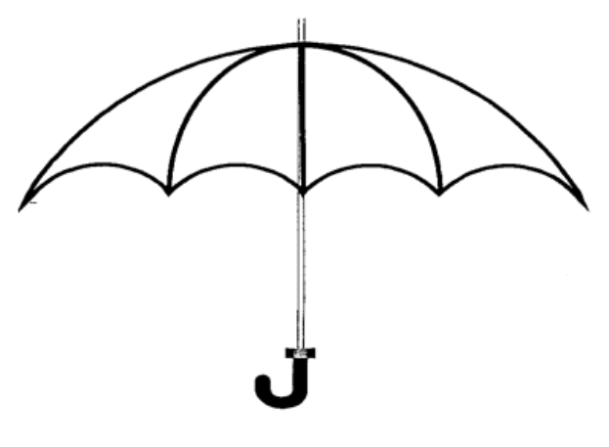
Phonological Awareness
Rhyme
Rhyme
Attending to the ending of words
sat, mat, splat, Matt

Slide 14
Phonological Awareness
Rhyme
Alliteration
Hearing alliteration
Attending to the beginning of words
sat, Sam, soup, small

Slide 15
Phonological Awareness
Sentence
Rhyme
Alliteration
Sentence
Words put together to convey meaning.
The small dog is furry.

Slide 16
Phonological Awareness
Rhyme
Sentence
Alliteration
Word
Word
A sound or combination of sounds put together that has meaning and is spoken or written.

Slide 17
Phonological Awareness
Rhyme
Sentence
Onset Rime
Alliteration
Word
Onset-Rime
Initial consonant or consonant cluster of a word
b – at, sw – im

Slide 18
Phonological Awareness
Rhyme
Sentence
Onset Rime
Alliteration
Word
Phoneme Awareness
Phonemic Awareness
Narrow subcategory of phonological awareness
Ability to identify and manipulate phonemes

Slide 19
Phonological Awareness
Sentence
Onset Rime
Rhyme
Word
Phoneme Awareness
Alliteration
Phonemic Awareness
Ability to identify and manipulate individual speech sounds (phonemes) of spoken word.
Phoneme Segmentation
Breaking apart words into speech sounds
Black = /b/ /l/ /a / /k/
+
Orthography
Writing system for representing language
Letter and letter patterns
PHONICS
˘
Phoneme Blending
Blending sounds into words
/b/ /l/ /a / /k/ = black
˘
Applying symbols to sounds

Slide 20

General principles of teaching phonological skills
* Follow the order of skill development.
* Begin with the easiest task and build on it as concepts are mastered.
* Continually review concepts previously learned.

Slide 21
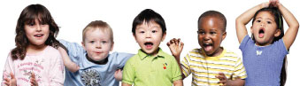
* Focus on speech sounds before focusing on letters (attentive listening).
* Encourage mouth awareness (phonemes are speech gestures as well as speech sounds).
* Include all English phonemes, even vowels and digraphs, in your
instruction.

Slide 22
* Think multisensory.
VAKT – Visual, auditory, kinesthetic, and tactile
* Provide direct instruction.
I do. We do. You do.
* Give immediate corrective feedback.
* Use letters to represent sounds as soon as your students are ready.
Note: A few brief activities, about 5-10 minutes/day, for about 12-20 weeks is all most students will need to improve in their phonological awareness.

Slide 23
Observation and diagnostic teaching
Formal and Informal Observation
Diagnostic Teaching
* If students aren’t getting it, change how you’re teaching it.
* Tailor home activities for added practice.
* Organize small groups or work one on one with classroom volunteers in order to specifically address deficits.
* Confirm individual automaticity in each phonemic awareness goal.
* Identify those who need further instruction or practice.

Slide 24

Foundation for phonemic awareness instruction
Prior to working on phonemic awareness, beginning readers should have acquired:
Perception and memory for sounds
Attentive listening skills
Understanding word and syllable segmentation

Slide 25
PA activities must be:
developmentally appropriate
adaptable to the diverse skill level of your students
(differentiate for individual students, review when necessary)
Engaging
Centered around physical activity, active participation

Slide 26
Sampling of Activities:
Listening - Teach Rhyming Songs use objects and/or actions to reinforce (“Twinkle, Twinkle, Little Star”) Who Says What? listening to sequences of sounds and imitating (animal noises or musical instruments)
Rhyming - Rhyme It! sound categorization using rhyming pictures or objects, What comes next? read rhyming phrase, have the students finish the ending (cloze-technique ”Jack and Jill went up the _____”), Rhyming Triplets show a pair of rhyming objects or pictures-say the names (‘cake-snake)’, child repeats and adds a third rhyming word
One-to-One Correspondence - Listening Detective sound counting activities (moving disks for every knock), Step out the Words hop for each word in a sentence, Clap the Syllables, How Many Sounds? count sounds of words, with 2 or 3 phonemes on fingers
Phonemic Awareness - Which doesn’t belong? show objects/pictures of objects (map, moon, apple, mouse) and students identify which example doesn’t belong, Sound Bingo matching sound to picture, I’m Thinking of Something provide first sound and additional descriptors until word is guessed (It starts with /b/, it’s yellow, it’s a fruit . . .), Pretend Play talk about the animals/toys, discover first sound, could match with other objects with same first sound, Sound Isolation substitute isolated phonemes with beg. sound of various puppets, using familiar tunes (“Happy Birthday” becomes ‘Lala, lala, la, la’), Guess the Word pronounce words segmented into onset-rime (Guess the word ‘m-oon’) can also segment by phoneme or syllables

Slide 27
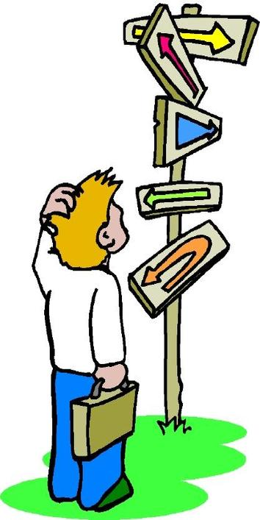
Planning:

Slide 28

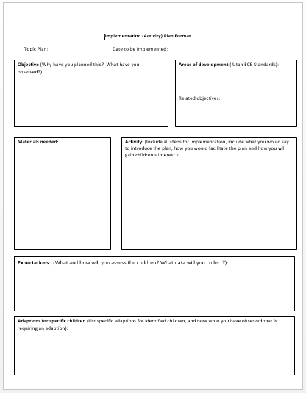

What are my goals?
yearlong → weekly → daily
Baseline observation/assessment
Planning-activities, prompts, script
Ongoing observation/assessment
Re-evaluating → planning the next activity
  TEACH WITH PASSION, MANAGE WITH COMPASSION.
  How well you teach = How well they learn. Anita Archer
Notes:
-

Slide 29
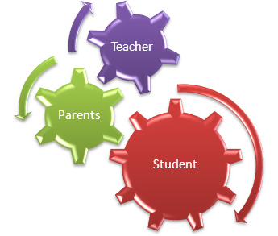

Parent education
Parents “play an important foundational role in the child’s learning and achievement. When parents, educators, and caregivers work together in the education and well-being of a child, a partnership is formed that will influence the best possible learning outcomes for the learner.”
(Utah’s Early Childhood Core Standards)

Slide 30
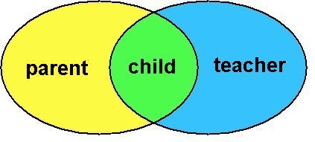
Parent/Teacher partnership
* Create and maintain open and regular two-way communication.
* Invite parents to on-site programs and activities when possible.
* Coordinate class work with home learning experiences.
* Collaborate with parents.
* Share tools with parents so they may help their child solidify concepts at home.

Slide 31
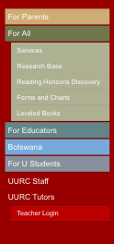
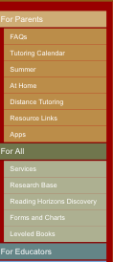
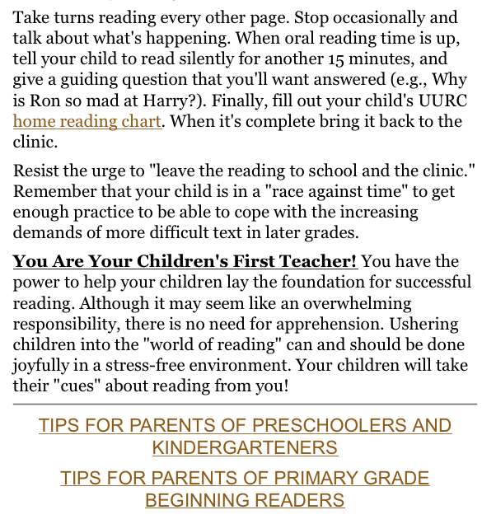
uurc.org / Tips for Parents

Slide 32

Phonological Awareness Seminar Assignment
    Develop PA activity using the Implementation Plan Format (IPF)
Video lesson while implementing with student(s)
View video
Write a one page reflection, that includes:
What went well? What did you learn? What would you change?
Due: Thursday Feb. 9
Include your completed IPF and 1 page reflection
  TEACH WITH PASSION, MANAGE WITH COMPASSION.
  How well you teach = How well they learn. Anita Archer

