Slide 1
Dyslexia basics
What Parents and Educators Need to Know

Slide 2
University of utah reading clinic
Dr. Kathleen J. Brown
www.uurc.org
801-265-3951

Slide 3
Take This to the Bank:
Good readers take in almost every word on the page. They recognize words at sight. With an unfamiliar word, they use spelling patterns to quickly chunk the word by syllable.
Poor readers rely on context to identify words.
Adams, 1990, Perfetti & Lesgold, 1979; Rayner & Pollatsek, 1987; Stanovich & Stanovich, 1995

Slide 4
black green black
green red green
blue black red
red green blue
green blue black
red black green
black green blue
green blue red
red green black

Slide 5
He had never seen dogs fight as these wxxxish cxxxxxxxx fxxxxt, and his first exxxxxxxxx txxxxt him an unfxxxxxxxble lxxxxx. It is true, it was a vixxxxxxx exxxxxxxxx, else he would not have lived to prxxit by it. Cxxxx was the vxxxxx. They were camped near the log store, where she, in her friendxx way, made adxxxxxx to a husky dog the size of a full-xxxxx wolf, thxxxx not half so large as xhe. Thxxx was no wxxxing, only a leap in like a flash, a metxx clip of teeth, a leap out exxxxly swift, and Cxxxx’s face was ripped open from eye to jaw.

Slide 6
What Causes Reading Difficulties?
The Source(s) of Reading Difficulties are
<----------------------------------------------------------------------------------->
Constitutional and/or Environmental
(in the child) (outside the child)

Slide 7
Important Terms
Phoneme: An individual speech sound. (/sh/, /ŏ/, /p/)
Grapheme: A letter or letter group that represents a speech sound or phoneme. (sh – o – p) Not synonymous w/letter (s – h).
Morpheme: The smallest linguistic unit in a word that has meaning. (shop + ed)

Slide 8
Dyslexia Basics
Dys = abnormal; not in a positive way (Greek)
Lex = word (Greek)
Misconceptions (e.g., see backwards, words jump on the page, colored lenses, marching, eye training)
Core deficit is in language, specifically, the phonological system which causes difficulty matching speech sounds to letter symbols.
Math and oral language abilities normal or above

Slide 9
Does That Mean Dyslexics Don’t Hear Well?
A dyslexic’s auditory system is not impaired.
That is, the physiology of ears and hearing are within the normal range.
A dyslexic’s deficit lies in the BRAIN.

Slide 10
Could It Be a Problem with the Visual System?
A saccade occurs when the eyes make a small ‘jump’ from one fixation to the next.
Dyslexics ‘saccade’ like beginning readers (i.e., lots of regressions).
When reading improves, saccades improve, but saccadic training does not improve reading.
Dyslexia is not correlated with eye or eye movement problems.

Slide 11
Dyslexia: Not the Fault of the Visual System
Historically (and still), many believed that dyslexia was caused by visual problems…WRONG!
Reading is visually driven, but only in the sense that retinal images must be transmitted to the brain
Once images get to the brain, decoding/word rec occur via non-visual cognitive systems (e.g., phonological)
What look like visual probs (e.g., directionality) are sympotoms rather than causes

Slide 12
Visual Intervention for Dyslexics? No!
Given lack of scientific evidence, and high probability that visual treatment for dyslexia are theoretically flawed, the American Academy of Pediatrics & AETNA Insurance do not endorse and will not pay for these controversial treatments.
http://pediatrics.aappublications.org/content/124/2/837
http://www.aetna.com/cpb/medical/data/1_99/0078.html

Slide 13
Dyslexia is…
…a specific learning disability that is neurobiological in origin. It is characterized by difficulties with accurate and/or fluent word recognition and by poor spelling and decoding abilities. These difficulties typically result from a deficit in the phonological component of language that is often unexpected in relation to other cognitive abilities and the provision of effective classroom instruction. Secondary consequences may include problems in reading comprehension and reduced reading experience that can impede growth of vocabulary and background knowledge.

Slide 14
Dyslexia is a specific learning disability that is neurobiological in origin…
This definition has been adopted by:
International Dyslexia Association
National Institute of Child Health & Human Development (US Department of Health & Human Services)

Slide 15
Dyslexia
is not caused by a visual problem
is not caused by lack of motivation
occurs in all socioeconomic levels
occurs slightly more in boys than girls
may occur in spite of good classroom instruction
is resistant to intervention
may occur with other disorders (e.g., ADD)

Slide 16
A Non-Dyslexic Child’s Journey in G1
b d
/b/ /d/
Over time, speech sounds and graphemes processed simultaneously (automaticity). Result? No more mistakes!

Slide 17
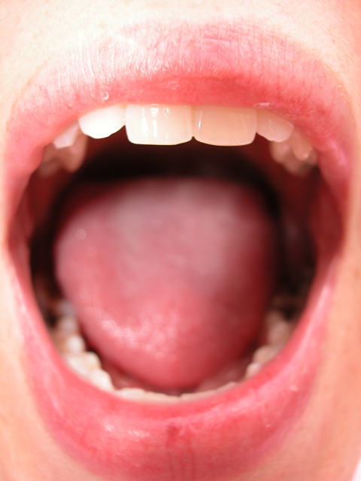
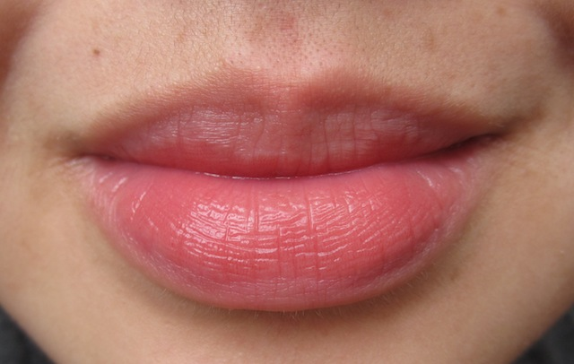
A Dyslexic Child’s Journey in G1 and On
b d
/b/ /d/
quit, quiet, quite and, said
ever, every, very ever what, that

Slide 18
Is My Child Dyslexic?
Timed tests of letter-names or letter-sounds in K & early G1.
Timed phoneme awareness (e.g. wug, sim) tasks in early G1.
Oral reading fluency, a timed test of reading rate and accuracy in connected text in G2 and up.
Poor spelling well below grade level expectations
Poor response to basic reading intervention

Slide 19
Identifying Reading Disability in Utah
Utah Schools may use any of the following options:
A. Response to Intervention
B. Discrepancy (1.5 s.d.) between reading achievement & intellectual ability
  e.g., IQ = 100 WRMT = 78
C. Combination of A & B above

Slide 20

The Team Approach
Student
Parents/Guardians
Classroom Teacher
School Psychologist
Speech & Language Pathologist
Academic Therapist
Content Area Teachers
Reading Specialist
Intervention Specialist
Occupational Therapist

Slide 21
Students Who Do Not Qualify for an IEP
For students with moderate reading difficulties who do not have IEPs, and who are unlikely to qualify for an IEP, a 504 Plan can be a life-saver!
A 504 Plan will allow accommodations that help a junior high/high school student to keep up with coursework and demonstrate optimum performance on standardized tests (e.g., ACT)
Teachers need to be in the 504 “loop” for the plan to work well. A 504 Plan is not “cheating!”

Slide 22
UURC Services
Basic Assessment Battery - $50
Intensive Assessment Battery - $100
      after intervention
Basic Intervention - 45 minutes 2x week
Intensive Intervention (Wilson) - 75 minutes 2x week
Professional Development for Educators (basic, intensive intervention)

Slide 23
What Can a Parent Do at Home?
Home Word Charts - http://www.uurc.utah.edu/General/HomeWord.php
Repeated Readings - http://www.uurc.utah.edu/General/Forms-Charts.php
More, more, and more! http://www.uurc.utah.edu/Parents/ParentLinks.php

Slide 24



www.uurc.utah.edu

Slide 25

For More Information
The International
Dyslexia Association
40 York Road
4th Floor
Baltimore, Maryland 21204
www.interdys.org
1-800-ABCD123
410-296-0232

