Slide 1
Making Tier I Text Accessible for LD Students in Secondary Classrooms:
improved fluency & Comprehension

Slide 2
Dr. Kathleen J. Brown
University of Utah Reading Clinic
www.uurc.org
http://www.uurc.utah.edu/Educators/Resources-Tier1.php

Slide 3
Reading comprehension
Reading comprehension = model of meaning readers constructs by using information from the text and background knowledge.
Within a text, comprehension occurs at the phrase level as the reader processes strings of letters. Ideally, this builds to comprehension at the text level.

Slide 4
What Affects (and Effects) Reading Comprehension?
Context
Context
Task
Reader
Text
Context
The RAND Heuristic (2002)

Slide 5
Instruction Should…
  help students be fluent with text,
  understand what the author is saying in the text right in front of them, right now,
  help students connect what they just read to what they read previously in that same text, and,
  help students build the capability to be more fluent & understand future texts

Slide 6
Problem:
Many Students Can’t Handle Tier I Text
Not much actual reading even in primary grade classrooms: < 9 minutes/day & some struggling readers as little as 1-2 minutes/day (Gambrell, 1984).
Round Robin Reading is ineffective (Ash, Kuhn, & Walpole, 2003).
Many students can’t decode, understand or remember what they read.

Slide 7
Vehicles to Help Students Read Challenging Text
Your grade-level text
Fluency-Oriented Reading Instruction (FORI) routines for fluency
Questioning the Author (QtA) routines for comprehension

Slide 8
FORI – QtA Simulation
Let’s try it!

Slide 9
Basics
Goal = at least 40minutes/day of ‘miles on the page.’
Weekly schedule of oral reading routines with consistent prompts.
Alternate oral reading with QtA comprehension work

Slide 10
FORI – QtA Routines
Day 1: Brief Preview → Read-To w/Basic Comprehension work
Day 2: Echo-Read same text w/Deep Comprehension work
Day 3: Partner-read same text w/Student Comprehension work

Slide 11
Day 1: Read-To w/Basic Comp
Work with chunks of text, stopping for basic comprehension work.
Read prosodically (pause @ phrase boundaries). Move around the room, using strategic cloze.
Use precise, consistent prompts.
  “Locate ___. My turn; you track.”

Slide 12
Day 2: Echo Reading w/Deep Comp
Work with bigger chunks of text, stopping for deep comprehension work.
Read prosodically. Move. Use strategic cloze.
Use precise, consistent prompts
    “Locate ___. My turn; you track.”
    “Locate ___. Voices together.”

Slide 13
Day 3: Partner Reading w/Student Comp
Students work in pairs: Lows w/Mids; Mids w/Highs.
Students use prompt: “Locate ___. Voices together.”
Pairs stop for Comprehension. “What does the author want us know from that part?”
Move around the room. Everybody on task?

Slide 14
FORI: Empirical Research
Stahl S.A. & Heubach, K.M., (2005). Fluency-oriented reading instruction. Journal of Literacy Research, 37, 25-60.
Kuhn, M.R., Schwanenflugel, P.J., Morris, R.D., Morrow, L.M., & Woo, D., et al. (2006). Teaching children to become fluent and automatic readers. Journal of Literacy Research, 38, 357-387.
Schwanenflugel, P.J., Hamilton, A.M., Kuhn, M.R., Wisenbaker, J., & Stahl, S.A. (2004). Becoming a fluent reader: Reading skill and prosodic features in the oral reading of young readers. Journal of Educational Psychology, 119-129.
Schwanenflugel, P.J., Meisinger, E., Wisenbaker, J.M., Kuhn, M.R., Strauss, G.P., & Morris, R.D. (2006). Becoming a fluent and automatic reader in the early elementary school years. Reading Research Quarterly, 41, 496-522.

Slide 15
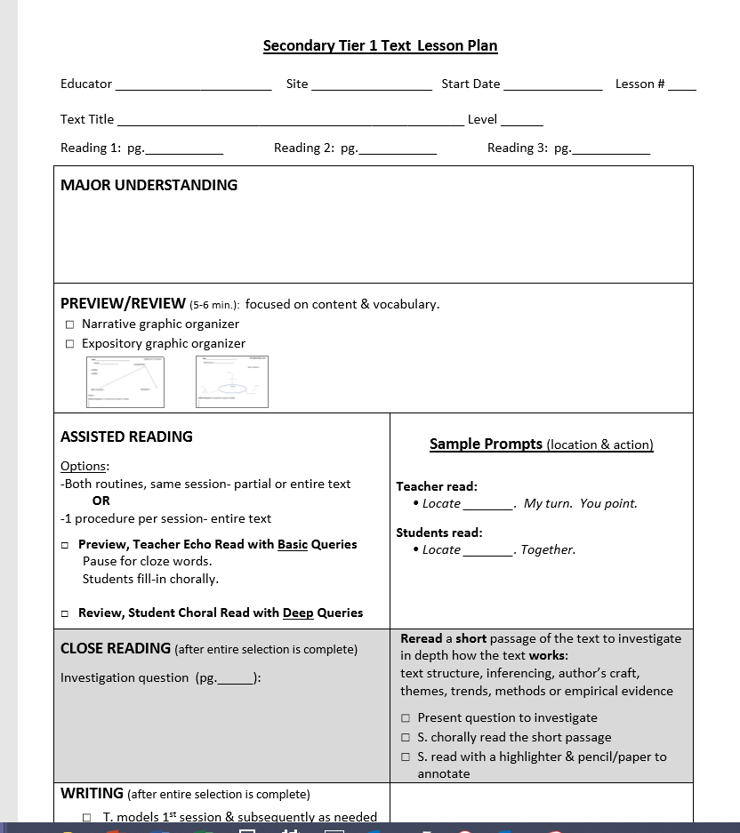

Slide 16
FORI: Application
Schwanenflugel, P.J., Kuhn, M.R. & Ash G.E. (2010). Setting the stage: Using oral and silent Wide Reading to develop proficiency. In E.H. Hiebert & D.R. Reutzel (Eds), Revisiting Silent Reading: New Directions for Teachers and Researchers (pp. 181-197). Newark, DE: International Reading Association.
Kuhn, M.R. & Schwanenflugel, P.J. (2009). Time, engagement, and support: Lessons from a 4-year fluency intervention. In E.H. Hiebert (Ed), Reading More, Reading Better (pp. 141-162). New York: Guilford.
Kuhn, M.R. & Woo D.G. (2008). Fluency-oriented reading instruction: Two whole-class approaches. In M.R. Kuhn & P.J. Schwanflugel (Eds), Fluency in the Classroom (pp. 17-35). New York: Guilford.

Slide 17
FORI: Research Findings
3 empirical studies
Kids need to be at least end G1 level.
Material should be challenging!
Scaffolding of multiple texts in a week is better than just 1 text.
Kids need 20-40 minutes of text per day to make gains.

Slide 18
QtA: Empirical Research
McKeown, M.G., Beck, I.L., & Blake, R.G. (2009). Rethinking Reading Comprehension Instruction: A Comparison of Instruction for Strategies and Content Approaches, Reading Research Quarterly, 44, 218-253.
Beck, I.L, McKeown, M.G., Sandora, C., Kucan, L., & Worthy, J. (1996). Questioning the Author: A year-long classroom implementation to engage students with text. Elementary School Journal, 96, 385-414.
McKeown, M.G., & Beck, I.L. (2004). Transforming knowledge into professional development resoureces: Six teachers implement a model of teaching for understanding text. Elementary School Journal, 104, 391-408.

Slide 19
QtA: Application
Beck, I.L., McKeown, M.G., Hamilton, R.L., & Kucan, L. (1997). Questioning the Author: An approach for enhancing student engagement with text. Newark, DE: International Reading Association.
Beck, I.L., McKeown, M.G., Hamilton, R.L., & Kucan, L. (1999). Questioning the Author Accessibles: Easy-access resources for classroom challenges. Newark, DE: International Reading Association.
Beck, I.L., & McKeown M.G. (2006). Improving Comprehension with Questioning the Author: A Fresh and Expanded View of a Powerful Approach. New York: Scholastic.

Slide 20
Qta: Research Findings
4 empirical studies
More on-task student talk
More talk about text itself and ideas in text vs. ‘fill-in-the-teacher’s-blank’
Student began asking more questions & acknowledging/responding to peers’ contributions
Outperforms reading comprehension strategy instruction

Slide 21
