Slide 1

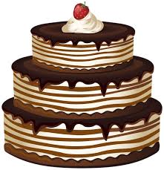
a

Slide 2
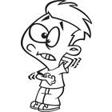
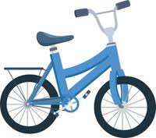
i

Slide 3

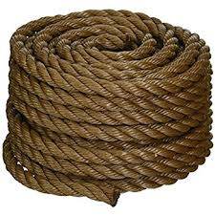
o

Slide 4

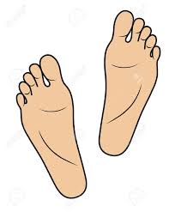
e

Slide 5


u

Slide 6

-ild

Slide 7

-ind

Slide 8
-ost

Slide 9
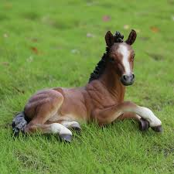
-olt

Slide 10

-old

Slide 11
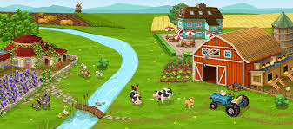
ar

Slide 12

ir

Slide 13
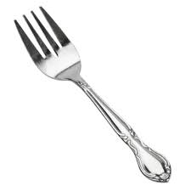
or

Slide 14
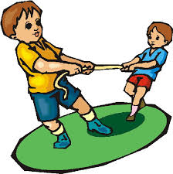
er

Slide 15

ur

Slide 16
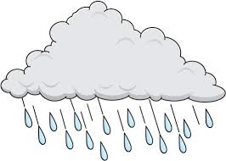
ai

Slide 17
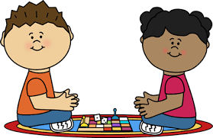
ay

Slide 18
ee

Slide 19
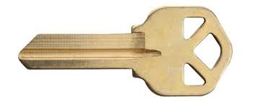
ey

Slide 20

oi

Slide 21

oy

Slide 22

au

Slide 23
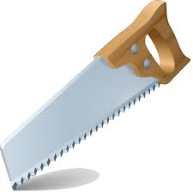
aw

Slide 24
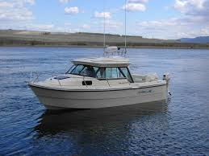
oa

Slide 25
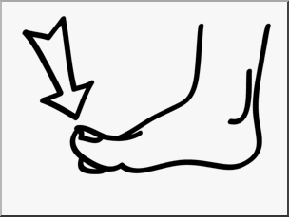
oe

Slide 26

ui

Slide 27
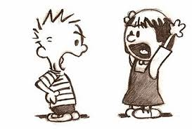
eu

Slide 28
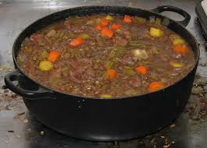
ew

Slide 29

ue

Slide 30
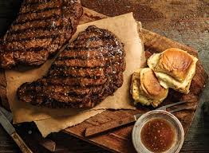
ea
eat, bread, steak

Slide 31
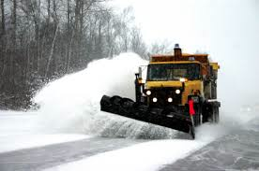
ow
snow, plow

Slide 32

ou
loud, group

Slide 33
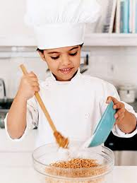
oo
cook, food

Slide 34
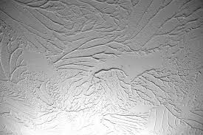
ei
ceiling, vein

Slide 35
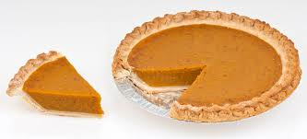
ie
piece, pie

