Slide 1
3.6
Accuracy Activity: Concept Points

Slide 2
Concept Points
Class Teacher
Select a student to tally points on whiteboard.
Provide copy of Concepts (see AWS Instructions & Activities) to each student.
Display 2 words. Model identifying all relevant concepts by syllable with one word (see table below). S. scorekeeper awards T. a point for every concept stated.
Students take turns identifying concepts with remaining word. T. tallies points earned per concept. S. may “phone a friend” to confirm their answers. Prompt possible concepts as needed.
Encourage S. to name individual concepts quickly. If 10-15 seconds lapse, other S. can the earn points by identifying concepts that were missed for that word.
When all relevant concepts are identified, repeat steps 3-4 for additional words as time allows.
Tally points to find a winner.

Slide 3
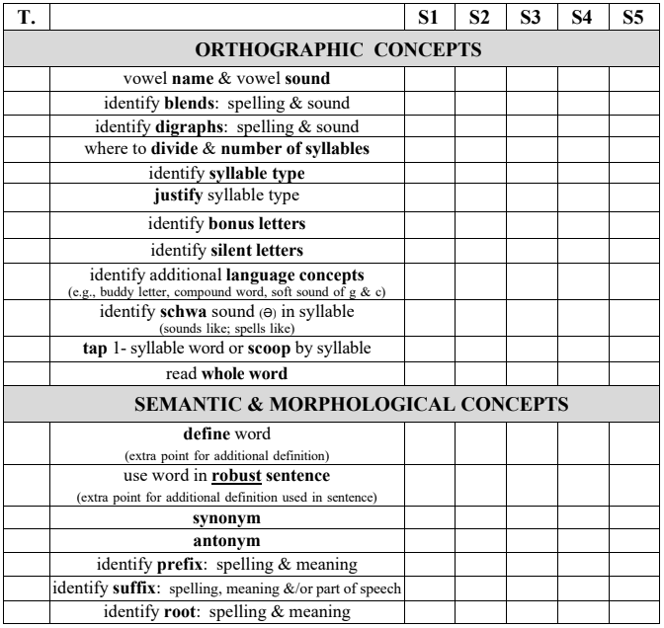

Slide 4
Possible Concepts
Identify Vowels & Consonants
Blends: Spelling & Sound
Digraphs: Spelling & Sound
Where to break
Justify syllable types (e.g., closed because…)
Vowel sound or schwa
Other language concepts (buddy letters, soft sound of c & g)
Scoop & read,
consolidate
Define word
Use word in 1 sentence

Slide 5
consent except

Slide 6
custom problem

Slide 7
complex adjust

Slide 8
conduct attempt

