Slide 1
10.3
Accuracy Activity: Name The Syllable Types!

Slide 2


Name the Syllable Types!
Choose 4-8 words of varying difficulty from the current module.
Review & display all taught syllable types on white board for reference (open & closed).
Echo spell the 1st word. S. write the word on their white board.
Prompt S. to mark vowels with 'x' & divided into syllables.
Then, prompt S. to identify & label the syllable types (see example).
Monitor as S. label, questioning to elicit error correction.
Wait for S. to finish, then prompt, Boards up.
Ask S. to identify previously taught language concepts for review (e.g., schwa, blends, digraphs, soft 'c' or 'g').
Continue with remaining words as time allows.

Slide 3
neutral
Notes:
vt/c

Slide 4
pursuit
Notes:
r/vt

Slide 5
suitcase
Notes:
vt/v-e

Slide 6
maneuver
Notes:
o/vt/r

Slide 7
raincoat
Notes:
vt/vt

Slide 8
authentic
Notes:
vt/c/c

Slide 9
cardboard
Notes:
r/vt

Slide 10
astronaut
Notes:
c/o/vt

Slide 11
automatic
Notes:
vt/o/c/c

Slide 12
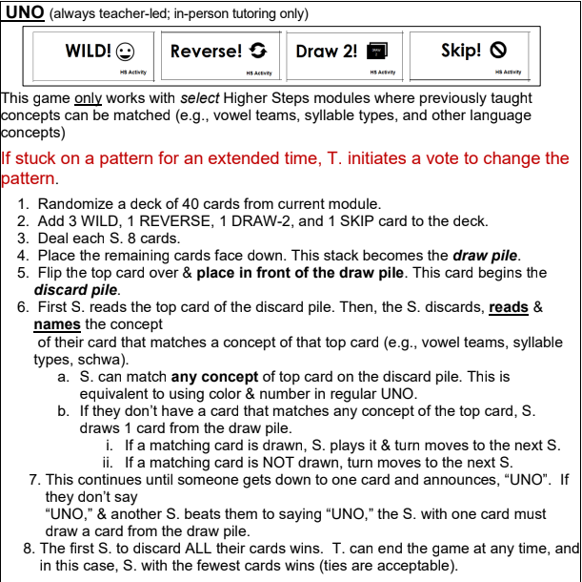

Slide 13
UNO
Set timer for 1:00.
Teacher displays word, students read chorally.
If POISON STAR turns up, whole class groans.
Play until time runs out or all words are read.
Repeat game as time allows, changing the location of the POISON STAR slides
Optional:
  Select 1 student to tally points on board.
  Split class into 2 teams.
  Set time for 1:00
  Teams take turns reading words, with the whole team reading chorally.
  1 point is earned for each word.
  If POISON STAR turns up, team loses all points.
  Play until time runs out or all words are read.
  Repeat game as time allows, changing the location of the POISON STAR slides
Team Fabulous Team Awesome

Slide 14
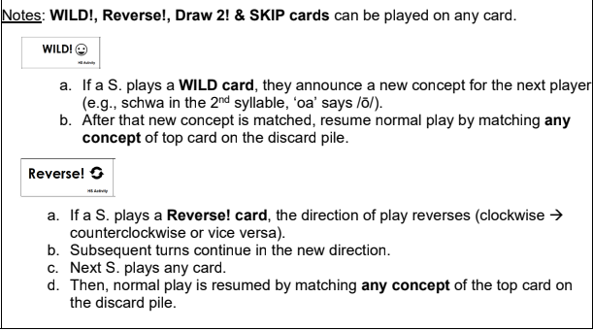

Slide 15
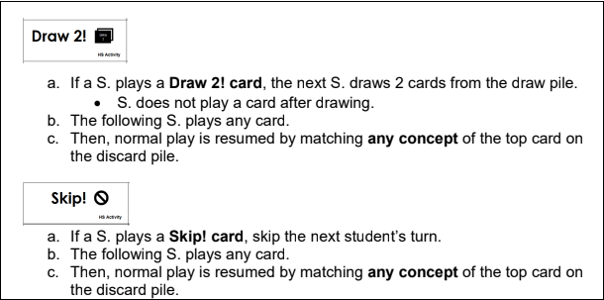

Slide 16
feud

Slide 17
fruit

Slide 18
grapefruit

Slide 19
neutral

Slide 20
juice

Slide 21
deuce

Slide 22
suit

Slide 23
maneuver

Slide 24
maneuver

Slide 25
pursuit

Slide 26
neutron

Slide 27
suitcase

Slide 28
sleuth

